Slide 1
GCSE Computer Science (9-1)
FUNDAMENTALS OF DATA REPRESENTATION
LESSON 2: binary arithmetic

Slide 2
Lesson Objectives
Be able to add up to three binary numbers
Be able to apply a binary shift to a binary number
Describe situations where binary shifts can be used

Slide 3
Starter
Write out the numbers 1-10 in binary
What patterns can you establish?

Slide 4
The First 10 Binary Numbers
1
10
11
100
101
110
111
1000
1001
1010
Can you see a pattern in how the numbers increase?

Slide 5
Adding binary numbers
To add binary numbers is relatively simple
We use the same principles of adding normal decimals
However, our result needs to fit in with the rules of binary
1 + 1 = 10

Slide 6
Rules of Binary Addition
0 + 0 = 0
0 + 1 = 1
1 + 0 = 1
1 + 1 = 0 carry 1
1 + 1 + 1 = 1 carry 1
Consider
Why do we use the
“carry” method?

Slide 7
Example
1011 + 101
Align the numbers in columns, as you would with a normal decimal
1011
101

Slide 8
Example
Add column by column applying the rules of binary addition
1
1
1
1
1011
101
10000

Slide 9
Now try these!
10110 + 1101
110010 + 10101
11010 + 1011
11010111 + 110001 What is significant about this one?

Slide 10
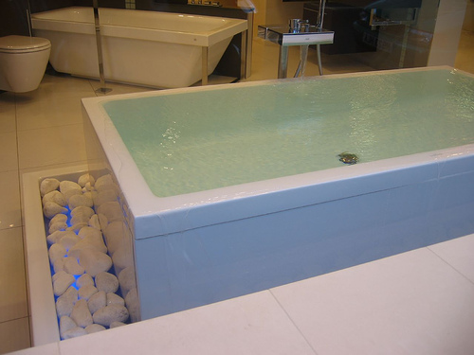
Overflow
Sometimes a binary addition will result in what we call overflow
Overflow is where an addition results in a value greater than 255 that requires a ninth bit
The problem of overflow is that either…
An extra byte is needed to store the value (taking up more memory)
The bit would just be discarded – an inaccurate sum!

Slide 11
Consider
As the place value increases in the binary number line, how does the number increase i.e. 1→2→4?

Slide 12
Try this out!
Here is a binary number
Here is the number with a binary shift left 1 place applied
Write both out as decimals – what is the effect of a binary shift?
0 | 0 | 1 | 0 | 1 | 1 | 0 | 1
0 | 1 | 0 | 1 | 1 | 0 | 1 | 0

Slide 13
Binary Shift
When we shift the decimal point in a normal number, it multiplies/divides by 10
This is because the base number of decimals is 10
The same principle applies to binary numbers
Shifting the place value by n places multiplies/divides by 2^{n}

Slide 14
Classwork
Now try some binary addition!
101 + 1
111 + 111
1010 + 1010
11101 + 1010
10010 + 1110
11111 + 10101
10101110 + 100111

