Slide 1
Gender and Crime

Slide 2
Nothing new just review
What do we know about girls in education?
Over time how has this changed and why?
McRobbie? Sharpe? Francis
Link between socialisation and education?
How do feminists view society?

Slide 3
Our aims today
To look at differences in statistics and possible explanations for these
revising the ‘chivalry thesis’
Sex role theory
Social control
Liberation Thesis

Slide 5
How might you explain these trends?
Socialisation?
Social control?
Are judges softer on women?
Role of patriarchy in explaining these?

Slide 6
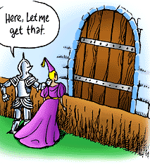
What can we remember about Chivalry Thesis?
What is chivalry?
This Photo by Unknown Author is licensed under CC BY-NC
This Photo by Unknown Author is licensed under CC BY
This Photo by Unknown Author is licensed under CC BY-NC-ND

Slide 7
Otto Pollak ‘Men hate to accuse women and thus send them to their punishment, police officers dislike to arrest them, district attorneys to prosecute them, judges and juries to find them guilty and so on.’ Men are socialised to be protective of women.

Slide 8
Graham and Bowling found that men are more likely to offend but the difference is smaller than recorded in official statistics. They found men are 2.33 times more likely than women to commit a crime whereas official statistics suggest this figure is 4 times more likely. Flood-Page et al found that 1 in 11female self-reported offenders had been cautioned or prosecuted in contrast to 1 in 7 men

Slide 9
How is this criticised?
Why else might women be punished less harshly than men?
What would feminists say?
1. Women are treated very harshly when they deviate from norms.
2. There are double standards in the law and it is patriarchal rather than women being treated better. Eg rape cases when the victim can feel on trial.

Slide 10
Carlen also argues The feminist perspective views crime as rational. The behaviour of women can be understood in the context of patriarchal society. Women are born, bred and raised in a society where men are in charge.
Pat Carlen (1990) – argued that due to the ‘class deal’ (material rewards) and the ‘gender deal’ (rewards from fulfilling roles), women are encouraged to conform to societies norms and values.
Most women just accept these deals and conform to society; they don’t want to commit crime because they have too much to lose, and so these deals prevent women from committing crime.
Carlen also suggested that women crimes are crimes of the powerless from the women who have not been offered these deals (such as being unrewarded in the family and workplace) and so can’t receive the rewards.
Therefore women commit crime as an alternative rational choice, for example shoplifting is an ‘easy’ alternative.
Evaluation of Carlen
(-) The theory is based on a study of only 39 participants, which may be too small of a sample size to make such generalisations.
(-) The theory suggests that women deviate from their social norms due to feeling unrewarded, but this doesn’t fit with the control theory

Slide 11
Sex Role theory
How else can we explain differences in crime statistics? Funtionalists would turn to looking at socialisation.
This Photo by Unknown Author is licensed under CC BY-SA
This Photo by Unknown Author is licensed under CC BY

Slide 12
Parsons (1937) argued that because females carry out the ‘expressive role’ in the family which involved them caring for their children and looking after the emotional needs of their husbands, that girls grew up to internalise such values as caring and empathy, both of which reduce the likelihood of someone committing crime simply because a caring and empathetic attitude towards others means you are less likely to harm others.
The child caring role also means that women are also effectively more attached to their families and wider communities than men – It is traditionally women who keep in touch with relatives and get to know their children’s friends families and thus bond local communities together. In terms of bonds of attachment theory, women are thus more attached to wider society and thus less likely to commit crime.
Similarly, because traditional female gender roles involve women being busier than men, especially since they have taken on the ‘dual burden’ and ‘triple shift’ in recent decades, this reduces the opportunities for women to commit crime.
It has long been theorized that the early socialization of boys into traditional masculine identities is at least partly responsible for the higher male crime rate. Sociologist Sutherland (1960) stated this very simply by saying that ‘boys are taught to be “rough and tough,” which makes them more likely to become delinquent’. Talcott Parsons (1964) purported that masculinity was then internalized during adolescence, which led to boys engaging in more delinquent behavior than girls, and sub cultural theorists Cloward and Ohlin (1960) proposed that in gangs, younger members learn through contact with older males that traits such as toughness and dominance are necessary in order to assert a strong masculine reputation.
One possible criticism of sex-role theory is that it is less relevant in today’s society because of the decline of traditional gender roles

Slide 13
Is it true that men learn to be naughtier and more violent than women?
This Photo by Unknown Author is licensed under CC BY-NC-ND

Slide 14
Social Control
How are girls controlled at home?
This Photo by Unknown Author is licensed under CC BY-SA

Slide 15
Abbot and Wallace – young women are more closely watched by their families and have less freedom so less opportunities for crime.
Outside the home women are expected to dress and behave respectably.
Heidensohn

Slide 16
Liberation thesis
Society is becoming less patriarchal so perhaps female crime will increase?
White collar crime?
Violent crime?

Slide 17
Do we accept liberation thesis? p109

Slide 18
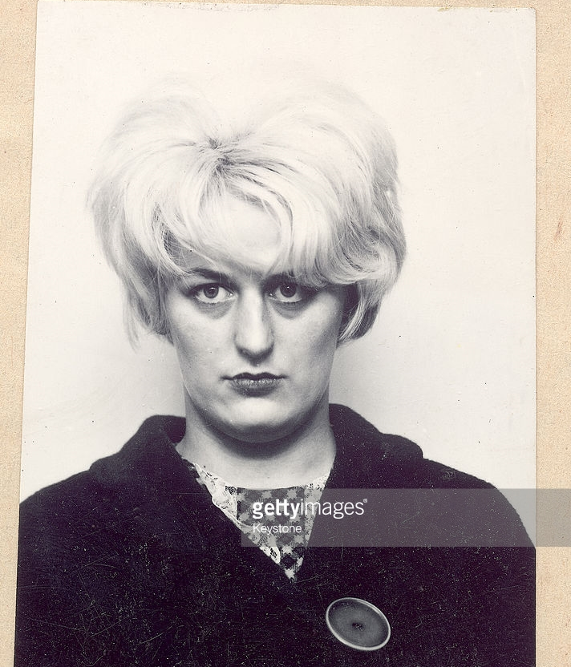
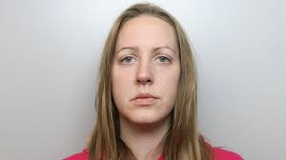
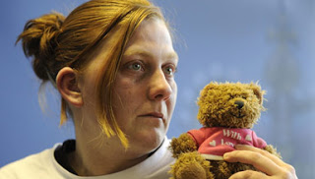
Your task
Karen Matthews, Lucy Letby and Myra Hindley. Now choose one of these and apply the theories we have learnt to their case to consider how people reacted to them. You will need to apply the chivalry thesis, and criticisms of the chivalry thesis showing that women are actually treated more harshly when they deviate from gender norms. Examine whether their case challenges the 'sex role theory' and whether their crimes supports the liberation thesis. Write something up however you like and be ready to present to us and tell us what you have learnt on Monday
This Phoo by Unknown Author is licensed under CC BY-NC-ND

