Slide 1
Paper 1 revision tips

Slide 2
Think about your revision for Paper 1 in 3 areas
1. Short questions and 10 marker with Item 20 marks altogether (25 %)
2. Advanced info policies stuff 30 marks altogether (37.5 %)
3. Methods in context and theory and methods 30 marks altogether (37.5%)

Slide 3
Part 1. Short questions and 10 marker with Item

Slide 4
Short questions and 10 mark with item will be straightforward
Thorough revision of remaining topics for these, keep trying those short questions and return to booklets to ensure depth of understanding.
Booklet 1 - role and function of education system
Booklet 2 – relationships and processes within schools
Booklet 3 - Differential educational achievement of social groups: social class
Booklet 4 - Differential educational achievement of social groups:ethnicity
Booklet 5 - Differential educational achievement of social groups: gender
Remember 10 marks with item includes evaluation, look for the two hooks and include theorists. You are now so good at these.

Slide 5
Part 2 – advanced info policies

Slide 6
Remember advanced information….
4.1.1. Education
• the significance of educational policies, including problems of selection, marketisation and privatisation, and policies to achieve greater equality of opportunity or outcome for an understanding of the structure, role, impact and experience of and access to education; the impact of globalisation on educational policy.

Slide 7
Some useful links below
This is very broad topic, probably best further broken down into a number of separate bullet points:
There are FOUR broad types of policy:
1 selection policies
2 marketisation policies
3 privatisation policies
4 policies to achieve greater equality of opportunity or outcome,
You need to be able to consider all of the above policies have affected the social structure and other institutions, the way in which (different types of) student experience school, and how they have affected equality of access to education, and educational outcomes (who gets what results).
In addition to all of the above you also need to be able to discuss and evaluate the impact of globalisation on educational policy!

Slide 8
Booklets and my long powerpoint are the best resource but you can use the below
These topics on ReviseSociology.com
NB the exam board has been asking students to focus on policies ‘since 1988 for several years’ so I think it’s reasonable to expect the same
Every student should know in depth the 1988 Education Reform Act – which introduced Marketisation.
New Labour’s policies carried on with Marketisation (choice) and introduced more policies to do with equality of opportunity
The Coalition’s Policies included Free Schools (more choice) and the Pupil Premium – the later an attempt at
Selection Policies include the tripartite system from the 1940s, but the linked post in this bullet point covers more recent selection policies and concepts such as ‘selection by mortgage’
Privatisation polices come in two ‘broad types’ – endogenous and exogenous, covered in this linked post.
Globalisation and Education is covered here
You will find more links to posts on education policies on my sociology of education page.

Slide 9
Globalisation (this is the trickiest topic)
Include
1. International league tables
2. Increase in different types of schools
3 Expansion of privatisation in the education system
4. The creation of British Values and PREVENT.

Slide 10
1. International league tables
1. International league tables
Globalisation has influenced educational policy in the UK is through the creation of international rankings.
Ranking systems, such as the PISA tests, enable education systems to compare the performance of their students in maths, English and science against students globally.
This is like the introduction of league tables in the UK.

Slide 11
Impact of international league tables
Positives?
Governments can easily compare the performance of their own students against those of other countries and this enables them to quantitatively examine the impacts of teaching, learning and assessment strategies as well as government educational policies.
This enables them to pick the strategies that they believe will have the biggest impact on students in the UK and implement those strategies.
An example of this is the proposal by then Education Secretary Michael Gove to extend the school day to mirror the longer hours in east Asian countries like South Korea and Singapore in order to improve student outcomes.

Slide 12
Impact of international league tables
Negatives?
However, many critics would suggest that ‘cherry picking’ policies from a nation that is performing well has a limited impact unless other social policies are implemented to compliment the educational policy.
For example, Scandinavian countries with more socially democratic ideals tend to perform well but rely upon an expanded welfare state and a more collectivist mentality than is present in the UK with neoliberal ideologies and policies that target individuals. This limits the impact of international league tables

Slide 13
2. Increase in different type of schools?
The concept of academies comes from the US Charter School system, whilst Free Schools are influenced by the Swedish Education System.
This was expanded further under the Cameron and Clegg government of 2010-2015 with proposals under the subsequent Conservative government to academize all secondary schools in the UK.
This was heavily influenced by global economic policy of neo-liberalism, reducing state spending and allowing market forces to dictate the education market..

Slide 14
Impact of different types of schools?
Good? Many like the introduction of city centre academies as tackling social inequality in areas of deprivation, the results of wide scale academisation have been less successful.
Bad? Recent investigations into the running of multi-trust academies have shown the impacts of corruption, under-staffing and poor outcomes for students.
Bad? Furthermore, Free Schools have predominantly benefitted the middle-classes in the UK as they have been set up by wealthy individuals and groups of middle-class parents, demonstrating that the influence of globalisation is primarily for those with more power and influence.

Slide 15
3. Expansion of privatisation in the education system
Examples - rapid expansion of the educational market to be a multi-billion-pound operation that provides large profits for UK based educational institutions. Eg Pearson is an international company, exams marked abroad etc.
The sale of naming rights by British public schools to overseas outlets,
The expansion of UK Universities to having international campuses and the
Growth of multi-academy trusts providing educational provision to the world’s lesser developed nations can be seen to be an influence of globalisation on governmental policy.

Slide 16
Evaluation of privatisation in education system - evaluation
Bad
Marxists would suggest that the spread of Western education with its ideals of meritocracy and capitalism is a form of cultural imperialism that facilitates the spread of capitalist ideologies such as neo-liberalism and individualism.
Good
This positively impacts on the employment prospects for students in the UK, who gain skills that are needed in the developing world.

Slide 17
4. The creation of British Values and PREVENT.
British Values is compulsory in all educational establishments to promote ideas of tolerance, the rule of law and democracy
PREVENT is a legal requirement for educational institutions to report what they perceive to be the threat of child exploitation, grooming or radicalisation.

Slide 18
British values and Prevent - evaluation
Bad - It can be argued that the impacts of both British Values and PREVENT have been controversial, with some universities challenging it on the grounds of academic freedom and others refusing to police their students.
Bad - Furthermore, it could be argued that it could lead to stereotyping certain ethnic groups within the education system and contribute to negative experiences, bullying and racism within schools.

Slide 19
Also prepare and revise marketisation / privatisation and policies that try to promote equality. These questions would be nicer
Use your theorists and the sample essays you have. You performed so well on this in the mock so will be straightforward.
Remember to mention the myth of meritocracy, parentocracy etc and if it is an equality question you can use what you know about external factors to evaluate.
Try to get those sociologists from the revision cards in

Slide 20
open enrolment. | ,expansion of universities 1992 | treating parents like consumers | Compensatory education | formula fundings,
Pupil premium | Education Reform Act | Sure Start | funding for literacy and maths skills, | Education Action Zones
Expansion of academies | Teaching skills for global economy | standardised testing | City Centre Academies | independent schools,
free schools and academies | EMA | external providers of servicers | Ofsted, | Creating competition
League tables | PISA | greater parental choice | multiculturalism in schools | Free-school meals
Marketisation | Privatisation | Equality of opportunity | Globalisation

Slide 21
Methods in context will be straightforward.
Remember to brainstorm before you start writing. Who, what, how and consider issues related to these (eg children/ parents / teachers have different considerations, what is being considered will have an impact on results as different topics are sensitive for different groups, how is your research method so remember strengths and weaknesses of these.
Who is the gatekeeper?
Structure as
Intro
1. practical +/-
2. ethical +/- and
3. theoretical +/-
Conclusion
Think about the issue being researched and ensure that you drop in some knowledge and theorists about this area.

Slide 22
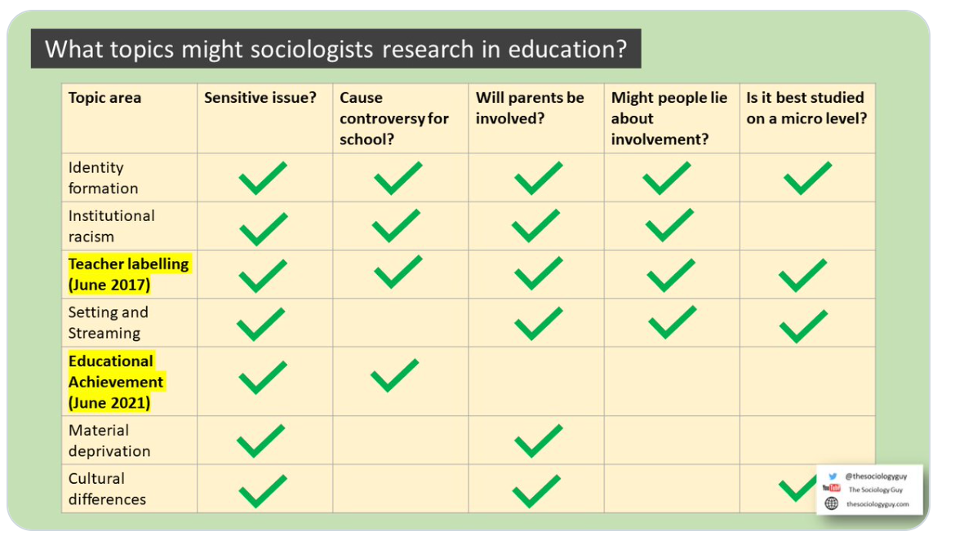

Slide 23
Brain storm
What do we need to think about with
Pupils
Teachers
Parents

Slide 27
10 marker theory / methods (use my theory and methods booklet to help revision) same for Paper 1 & 3
No item so these are outline and explain (no evaluation)
Hard to prepare for as so broad, you need to cover everything in revision.
Know all your methods with strengths and weaknesses of each and examples of research projects we have covered. All in revision powerpoint from that lessons (resources section of Firefly)
Know all your theory stuff for 10 markers. Unlikely to come from the advanced info (Marxism, Feminism, Functionalism and Action theories) but you need to look at these just in case.

Slide 28
Methods 10 marker topics
quantitative and qualitative (has come up before) methods of research; research design
questionnaires
Interviews
participant and non-participant observation (has come up before)
Experiments (has come up before)
Documents (has come up twice)
official statistics
the distinction between primary and secondary data, and between quantitative and qualitative data

Slide 29
Theory questions
the relationship between positivism, interpretivism and sociological methods; the nature of ‘social facts’
the concepts of modernity and post-modernity in relation to sociological theory
the nature of science and the extent to which Sociology can be regarded as scientific (has come up before)
the relationship between theory and methods
debates about subjectivity, objectivity and value freedom (has come up before)
the relationship between Sociology and social policy. (has come up before)

Slide 30
Possible focusses ?
Questions which have never come up.
Relationship between theory and methods
Post-modernism
I have planned out some sample answers for you below.

Slide 31
Outline and explain two ways theory may influence methods? 10 marks
1st way
Theory?
Might be a positivist / quantitative research, think sociology is scientific, want reliable and representative data. Durkheim believed real laws are discoverable. Example Durkheim and suicide.
Choice of methods?
Will choose methods like statistics and closed question questionnaires. You would want to identify trends in behaviour. Explain why positivists like these an give examples eg crime statistics, exam results by gender etc.
2nd way
Theory?
Might be an interpretivist and believe in qualitative. Weber believed that sociology was about meaningful social action (verstehen = empathetic understanding) also interactionists think you need to understand relationships between people for example labelling theorists like Becker might say crime statistics don’t tell us enough without context. Postmodernists and feminists also reject the idea that sociology is scientific, they think it is about discovering different truths and meanings.
Choice of methods?
Will choose qualitative methods such as interviews, observations explain why and give examples

Slide 32
Outline and explain two arguments that suggest that Society may have moved beyond modernity to a new stage of postmodernity.​ 10 marks
Argument 1 - globalisation
Globalisation is the greater inter-connection of nations into a global village.
This process has been helped by technological innovations, such as easier travel and the development of telecommunications networks.
Globalisation is a key feature of the post-modern age as it promotes massive cultural changes in society and influences the identity of individuals who draw ideas from other cultures and develop hybrid identities.
An example of this could be British Asian music or fusion cuisine.
Furthermore, the process of globalisation allows for more movement of people on a global scale and the transmission of ideas, norms and values from one part of the world to another. Post-modernists would argue, however that the process of globalisation can lead to the displacement of traditional national identities and that this is turn can lead to global conflicts, an example of this being the war on terror.
Baudrillard is concerned about the post-modern condition as it leaves us unable to distinguish image from reality. The media has created a ‘hyper reality’
Argument 2 - changes in how we define knowledge
Modernity focusses on science and rationalism but Baudrillard and Lyotard day our knowledge is much more fluid and is constantly changing.
Baudrillard talks about the links between postmodern society and consumption. He looks at how we consume ‘signs’. Society is based on buying and selling knowledge in the form of images and signs. These ‘signs’ stand for nothing on their own and are not symbol of a real thing. Eg a child might buy a poster of their favourite film character but this signifier (the poster) represents something that is not actually real (the character). He is very negative about society particularly television which he sees as confusing. We have lost our ability to tell what is real so we have lost our ability to improve society. We live in a ‘hyper-reality’ – we cannot tell what is real and what is not.
Lyotard Lyotard (1979) looks at the consequences this has for language. Claiming that we can not understanding language through one theory. There is not one overall language with set meanings. We play a series of ‘language games’ where different meanings exist in different contexts. Examples?
Categories are fluid in the same way that knowledge is now fluid.

Slide 33
Outline and explain two arguments that suggest that Society has not moved beyond modernity to a new stage of postmodernity (10).​
Paragraph 1
Post-modernism is too negative as sees everything as fluid and chaotic. Humans can act to change society.
It annoys Marxists because it ignores power and inequality, we do not freely construct our identities
Baudrillard is seen as too pessimistic Harvey says that we should be more optimistic about how to change society for the better.
Paragraph 2
Other explanations instead of post-modernism
Giddens not ‘post-modernity’ but ‘late modernity’ this has two characteristics
1.Reflexivity we constantly monitor our own behaviour, reflect and modify. Nothing is fixed or permanent
2.Disembedding we interact without meeting face to face so social relations are removed from interactions.
So there is constant change. This is a state of society with many risks such a military risks of war but unlike postmodernists Giddens thinks we can intervene to improve things.
Beck (1992) risk society. Urich Beck is in the enlightenment tradition. The means he believes in the power of reason to create a better world, he believes that this kind of society involves greater individualization. We are not ruled by tradition. SO we have to think for ourselves and reflect on the consequences of our actions. We must constantly take account of risks for ourselves (reflexive modernization).
Being risk conscious is central to our culture. He thinks society can be improved. We can ‘minimise risks’ on a political scale eg reducing the risk of nuclear war.

Slide 34
Good luck!!

