Slide 1
Definitions of crime and measuring crime
Acts that may be criminalised or decriminalised by governments e.g. drug classifications
NORMATIVE DEFINITION
Definitions of crime that change over time e.g. witchcraft
OFFICIAL STATISTICS
Questionnaires completed with individuals about whether they (or anyone in their household) have been the victim of a crime over the past year e.g. the British Crime Survey (BCS)
HISTORICAL CHANGES
Questionnaires or interviews designed to ask individuals (in confidence) how many crimes they have committed
SELF-REPORT STUDIES
A definition of crime that also takes a social or moral perspective e.g. the breaking of a moral and legal code
THE DARK FIGURE
Data that is collected by various government agencies such as the police, courts and prison service. The Home Office then produces a report collating all of the reported and recorded crime over a given period.
CULTURAL FACTORS
The number of crimes that do not appear in the official statistics (i.e. those that are not detected or reported and recorded by official agencies)
VICTIMISATION STUDIES
Religious laws that govern the behaviour of the population in some countries e.g. adultery is punishable in some countries
POLITICAL FACTORS

Slide 2
Give an example of a legal definition of crime
Name three techniques for measuring crime
Describe one advantage and one problem with official statistics
What name is given to a definition of crime based upon social and moral factors?
Define what is meant by a victimisation study and state how old you have to be to complete this
Over what period are people asked if they have been a victim of crime in a victimisation study?
Give an example of a normative definition of crime
Define what is meant by a self-report study
What is an advantage and a disadvantage of victimisation studies?
Defining and measuring crime timed challenge
Name three difficulties with definitions of crime
Explain how the Home Office might collect official statistics about crime
What is an advantage and a disadvantage of self-report studies?
Give an example of a case in which governments have changed the definition of crime
Name a specific type of victimisation study
What is telescoping?

Slide 3
Evaluating methods of measuring crime
A valuable source of data on attitudes towards crime and fear of crime.
Evidence in support comes from Wilson who found that whilst criminal convictions for a sample of 10-17 year old boys in a deprived area were 20% (usually for theft or burglary), 40% reported having shoplifted and 67% had engaged in minor vandalism (graffiti).
It allows the public to see how the government is handling crime and whether rates are increasing or decreasing.
It is a useful way to uncover the incidence of crime (actual number of offences committed) as well as the prevalence of crime (the number of people committing offences).
Lack of consistency in recording practices e.g. by police. This was investigated by Farrington and Dowds who found that Nottinghamshire police recorded property crimes of lesser amounts (£10 or less) compared to Staffordshire and Leicestershire police who perceived these illegal acts to be far less serious and so did not record them.
Local crime surveys have recently been conducted to complement the national surveys such as the British Crime Survey (BCS)
Many of the items in questionnaires cite juvenile acts and therefore, the extent of adult crime is less clear.
Many studies have involved young people who tend to exaggerate their responses which may inflate the values somewhat.
Measurement errors based on memory recall (individuals may experience memory decay and forget even quite recent incidents).
Not all crimes will be detected
Not all crimes will be reported (and therefore recorded). An example is rape where the female victim may feel that she will not be listened to, will have stigma attached to her, is too embarrassed or does not believe that the correct action will be taken, especially if it is a claim against a man that she knows.
Recording practices may be misleading and the overall data may be manipulated in order to look favourable to the public.
Several agencies hold their own records
Some criticise the method for un-representing certain types of crime as they focus on people and property (e.g. corporate crimes are excluded from the reports).
Some offences recorded by the BCS are no longer officially defined as crimes by the UK authorities.
Studies suggest that this method does not reveal the true extent of crime (known as the dark figure).
Telescoping may occur whereby the victim recalls an event that actually happened outside the time frame (thus increasing the crime statistics). Alternatively, individuals may incorrectly think events occurred more than 1 year ago and so not report crimes that should be included. These issues question the reliability/validity of such techniques.
The information has a number of uses e.g. it can provide police with information that can direct their resources toward certain types of criminal activity
The strategy helps to reveal the dark figure.
This strategy helps to reveal the dark figure.
This technique has been popular in the US for many decades.
This technique reveals wide gaps between actual crimes and official statistics.
OFFICIAL STATISTICS
VICTIMISATION STUDIES
SELF-REPORT STUDIES

Slide 4
SMALL SAMPLE SIZES
The type of crimes that the typology approach can be applied to
TYPOLOGY APPROACH
A third category to the typology approach (for those who can’t be categorised as either organised or disorganised)
CRIME RECONSTRUCTION
Where interactions between the person and the situation lead the person to behave differently in different situations
ORGANISED/DISORGANISED
A limitation of the typology approach regarding the interviews upon which the theory is based
Offender profiling vocab
MIXED
An investigative technique by which to identify the major personality and behavioural characteristics of the offender based upon an analysis of the crime(s) he/she has committed
DATA ASSIMILATION
The third stage of FBI crime scene profiling
RAPE AND MURDER
The type of offenders that the typology approach distinguishes between
OFFENDER PROFILING
An approach to offender profiling within crime scene analysis as used by the FBI
PERSON X SITUATION
The first stage of FBI crime scene profiling

Slide 5
Offender profiling quiz
POLICE LINE DO NOT CROSS POLICE LINE DO NOT CROSS POLICE LINE DO NOT CR
POLICE LINE DO NOT CROSS POLICE LINE DO NOT CROSS POLICE LINE DO NOT CR
Define offender profiling
What two types of crimes was offender profiling originally used for?
Name the US approach to offender profiling
Name the UK approach to offender profiling
Which approach to offender profiling refers to criminals as either organised or disorganised?
State two crime scene characteristics of an organised criminal
State two likely personality/behavioural characteristics of a disorganised offender
The typology approach can be applied to which two crimes?
Give two evaluative points of the typology approach
POLICE LINE DO NOT CROSS POLICE LINE DO NOT CROSS POLICE LINE DO NOT CROSS POLICE
POLICE LINE DO NOT CROSS POLICE LINE DO

Slide 6
POLICE LINE DO NOT CROSS POLICE LINE DO NOT CROSS POLICE LINE DO NOT CR
Douglas presented a third category to the typology approach (for those who can’t be categorised as either organised or disorganised). What was this called?
Offender profiling is based on which two assumptions?
What term is used to state that interactions between the person and the situation will lead the person to behave differently in different situations?
Which approach to offender profiling links crime scenes to the offender’s home and assumes that crimes will be committed close to the home/work place?
Name one case study where geographical profiling was used
Which psychologist is most commonly associated with geographical profiling?
What term is used to describe a mental schema of spatial information which is used by offender’s in their choice of crime scene/body disposal site?
Give two evaluative points of geographical profiling
What are the 4 stages of FBI crime scene profiling?
POLICE LINE DO NOT CROSS POLICE LINE DO NOT CROSS POLICE LINE DO NOT CR
POLICE LINE DO NOT CROSS POLICE LINE DO NOT CROSS POLICE LINE DO NOT CROSS POLICE
POLICE LINE DO NOT CROSS POLICE LINE DO

Slide 7
Evaluating offender profiling

Slide 8
Lombroso or Sheldon?
Criticised by West and Farrington.
Aimed to investigate if criminality was heritable
Claimed that criminals constituted a biologically distinct class of people who could not adapt to modern morality and had a tendency to show primitive characteristics e.g. strong jaws, heavy brows, lower than average intelligence.
Criticised by Goring
Empirical evidence using college students and delinquents
Failed to make comparisons between criminal/non-criminal groups (i.e. no control)
Ignored the fact that poverty could be the cause of the physical appearance rather than genetics
Known as atavistic theory
Criticised for being overly simplistic though could be relevant to teenage based crimes.
Linked criminal behaviour to bodily build (somatotype)
Linked physical build to personality and temperament
Originally thought that criminals were ‘born and not made’
Problem of expectations
Provided a lot of debate about criminality
Shows support within delinquent girls.
Had methodological flaws e.g. samples included a high number of people who would today be classified as suffering from a psychological disorder. May have therefore confused criminology with psychopathology.
Stated that there are 3 basic somatotypes: endomorph, ectomorph and mesomorph
Supported by Hartl et al. (1982)
The founding theory of modern criminality
Used samples of delinquents who had not actually been legally defined as delinquents.

Slide 9
Biological explanations of crime: Genetics
Genetic transmission
Twin studies – Grove et al. (1990)
Adoption studies – Mednick et al. (1984)

Slide 10
Biological explanations of crime: Neurophysiology, chromosomes and hormones
Neurophysiological explanations
Chromosomes
Raine et al. (1997)
Hormones

Slide 11
Evaluating biological explanations of crime

Slide 12
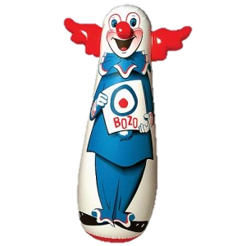
Learning theories of crime: social learning theory
SLT states that all behaviour is learnt (and therefore is the result of nurture). This takes place through the observation and imitation of models due to the expectation of rewards for doing so (or not copying because of the expectation of punishment). Where an individual is motivated, imitation will most likely occur.
Any response that is therefore reinforced by an individual in some way (e.g. by attention or money) will continue in the future whilst any response that is not reinforced or is punished, will cease.
Criminal behaviour must have therefore been learnt through past reinforcement.
Evidence for social learning theory
Evaluation
Mediating cognitive factors
Imitation
Models
Vicarious reinforcement

Slide 13
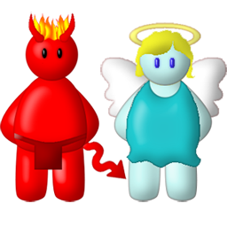
Learning theories of crime: differential association theory
What is differential association theory?
Evidence for differential association theory
Evaluation
How does this theory explain why individuals from the same background differ?

Slide 14
Learning theory and the biological approach quiz
Psychologist who developed atavistic theory
Structure of the brain linked to aggressive behaviour
A physical anomaly that Lombroso proposed as a criminal characteristic
Psychologist who linked brain structure to crime
Psychologist who criticised Lombroso’s theory
Disorder used as an explanation for offending
The three body types
Psychologist who linked hormones to crime
The psychologist who developed somatotype theory
Criticism of the biological approach as it breaks behaviour down too much
The criminal body type
Only measures the relationship between variables
A factor besides body shape that leads to increased aggression
Copying of behaviour
Studies used to investigate the genetic transmission of offending behaviour
According to SLT, the people who we imitate
Identical twins
The theory proposed by Farrington
Investigator of criminality in MZ twins versus DZ twins
Evidence in support of SLT

Slide 15
Evaluating learning theory explanations of crime
1 A strength of the social learning theories explanations into offending is that it provides us with real-world application.
2 Observational studies involve watching and recording people’s behaviour. They often take place in artificial settings therefore they lack ecological validity. This is a limitation because the results from the study will not be generalisable to the real world.
3 Although this study indicates that role models and imitation play a part in a person’s criminal behaviour, this may not be the case in real life. The participants in the study were working class therefore they were earning an income which is considered a reinforcement. Therefore, the participants may have performed criminal acts due to their own decision making and not because of family criminality. This also suggests that the research could be taken as evidence for a genetic theory of offending, since a high percentage of the sample had biological parents who were criminals, thus disregarding the learning theories.
4 The social learning theory therefore has allowed us to understand how violence in the media can change the behaviour of young children and that by allowing children to watch aggression you are allowing them to imitate the behaviour which can them influence them to perform criminal acts.
5 This is supported by Osborne and West’s study who found that where the father had a criminal conviction, 40% of sons also acquired one by the age of 18, compared with only 13% of the sons of non-criminal fathers.
6 By having this real world application means that we are able to lower levels of aggression by protecting children from violence in the media e.g. TV and video games which could ultimately lower crime rates.
7 Sutherland stated that the basic prediction of differential association theory is that people who become offenders will have been socialized in families and group where there are some pro-criminal norms; There should therefore be evidence of pro-criminal norms and probably criminal activity in the families and peer groups of offenders. This idea of pro-criminal norms disregards all other theories to offending such as the biological explanations as Sutherland argues that if a child acquires more attitudes that are favourable to crime than unfavourable ones, the result will be that they regard criminal behaviour as acceptable.
8 A limitation of the learning theories of offending is that in order to assess a change in behaviour in terms of aggression due to reinforcement, observational studies must be carried out.
9 A strength of the learning theories of offending is that there is some evidence to support the idea of pro-criminal values within families as people with criminal parents run a higher risk of becoming criminals themselves.
10 It is well known in our society that criminals are frequently caught and imprisoned, a fairly salient observed punishment. It is also the case that most people work in legitimate employment to acquire reinforcements such as money and status, another very obvious set of models and observed reinforcements. This being the case it is not clear why people behave criminally at all if the vast majority of models and reinforcements should promote non-criminal behaviour.
11 Although this study showed that children imitate aggression from models which could also lead to criminal behaviours being imitated, the study’s findings cannot be generalised to the real world. The method relies on research conducted in artificial settings therefore behaviour observed may not be reliable and that the children in Bandura’s study may have acted differently as they were influenced by demand characteristics. In real life, the children may respond differently towards humans than the way they responded towards the Bobo doll.
12 This therefore provides empirical evidence that a child may perform criminal acts based on the acceptance of their parents’ pro-criminal views.
13 For example, Bandura used the experimental observation method to investigate the role of models in aggression. He tested 72 children half male half female who were divided into groups who watched an aggressive or non-aggressive model play with a bobo doll. The model was either the same or different sex. The children were then taken separately to an experimental room and were allowed to play with the bobo doll. The observers rated the children for how much they displayed evidence of imitating aggression or non-aggression. The results showed that the children would imitate the behaviour they saw, although the likelihood of modelling depended on the characteristics of the model and whether they were seen to be a reward or punishment.
14 For example, Farrington et al carried out the Cambridge Study of Delinquent Development, a longitudinal study. A group of 411 working-class boys and their families, from a deprived inner-city area of south London, were studied from the age of 8 years in 1961 to the age of 50 years. Researchers recorded details of family background, parenting styles and school behaviour. They also recorded the rate and type of convictions at various points. 41% of the sample were found to have had criminal convictions between the ages of 10 and 50 years.
15 A limitation of the learning theories of offending is that it underplays the role of cognitive factors, such as decision making, in criminal behaviour.
16 For example, the Columbine massacre in which the two boys involved in the murder of 13 students and teachers and wounding of 23 others before committing suicide were said to have been avid players of the computer game Doom; a game licensed in the US military to train soldiers to effectively kill. The boys had created a video a year before this event in which they acted out the game wearing trench coats and carrying weapons. This would suggest that the theory indicating that violence in the media can cause criminal behaviour in young children has real world application.

Slide 16
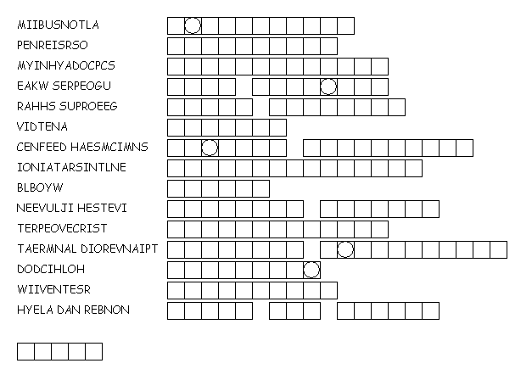
Psychoanalytic explanations of crime
Describing the psychoanalytic explanations for crime

Slide 17
Evaluating psychoanalytic explanations of crime

Slide 18
THEORY
DESCRIPTION
Key theorists/Studies conducted
Strengths
Limitations
Biological
Psychoanalytic
Learning theory

Slide 19
A A strength of Eysenck’s theory | B What Eysenck linked crime to | C The questionnaire developed to measure a person’s E and N score | D The amount of stimulation required by the environment
E A measure of anxiety and unstable moods | F The third personality trait identified by Eysenck | G A part of the nervous system linked to an E score | H A process that does not easily occur with a high N score
I A criminal displays this level of E, N and P | J These are personality characteristics of a high P score | K E, N and P are related to this biological factor | L A limitation of Eysenck’s theory
M The two dimensions of extraversion | N A psychologist who has famously criticised Eysenck’s theory | O These characteristics are most commonly found in prisoners
Eysenck’s Theory
1 Genetics | 2 ANS | 3 Extraversion | 4 Cold, uncaring, solitary and aggressive
5 Personality | 6 EPQ | 7 Sociability and impulsiveness | 8 Psychoticism
9 Neuroticism | 10 Conditioning | 11 Farrington | 12 Generates predictions that are easy to test
13 High N and P scores | 14 High | 15 Inconsistent E scores
A = | B = | C = | D = | E = | F = | G = | H =
I = | J = | K = | L = | M = | N = | O =

Slide 20
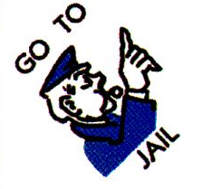
Incapacitation
Definition
Rehabilitation
Role of Custodial
Sentencing
Retribution
Deterrence
Behaviourism and custodial sentencing

Slide 21
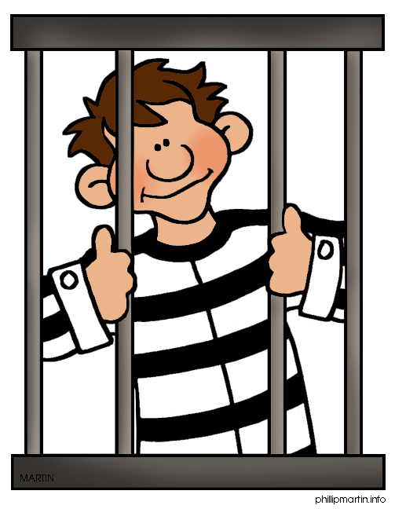
Stress/Depression
Suicide
The Psychological Effects
of Custodial Sentencing
Institutionalisation
Prisonisation

Slide 22
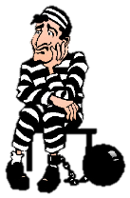
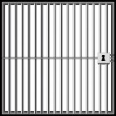
Factors Affecting the Psychological Effects
of Custodial Sentencing
Length of sentence
Type of institution
Overcrowding
Personality of prisoner (individual differences)

Slide 23
The advantages and disadvantages of custodial sentencing
Custodial sentencing is based upon the behaviourist principle of operant conditioning and this punishment acts as a deterrence to people who may commit crime or prisoners from committing further crime once they are released from the institution.
Negative psychological effects have been associated with a prison environment, particularly for those prisoners who have a longer sentence. These negative psychological effects include stress/anxiety/depression, suicide, institutionalisation and prisonisation. This has been shown empirically by Zimbardo.
Custodial sentencing provides the individual with a criminal record which can have a negative effect upon their opportunities for finding future employment (NB this is also true of other forms of punishment based upon a criminal conviction).
High recidivism rates would suggest that prison does not act as a suitable deterrence as predicted. In the UK, recidivism rates have shown that 1 in 4 prisoners reoffend. Given that some prisoners may not be caught committing these additional crimes, the true recidivism rate may actually be higher.
Prison offers the opportunity for retribution with the public being able to exact justice upon the criminal to which they have been a victim. For serious offences such as rape and murder, it is important that justice is reached.
Prison offers an opportunity for rehabilitation. Various reform programmes are available such as drug treatment programmes and social skills training. These allow the prisoner to acquire more socially acceptable skills that reform them from a life of crime upon their release. It may also lead to them acquiring more socially acceptable and therefore less aggressive, criminal behaviours (e.g. in the case of anger management).
Incapacitation is an advantage of prison in that it prevents criminals from being able to commit further crimes upon society. This is essential for more aggressive crimes including rape and murder.
It has been argued that prisons provide a “college of crime” with offenders learning new skills and techniques for committing crimes, possibly advancing towards more serious crimes.
Educational opportunities and skills may also be available for prisoners e.g. teaching electrician and plumbing skills. This provides prisoners with the opportunities for employment upon their release in order to prevent them from committing further crimes by having a more regular income.

Slide 24
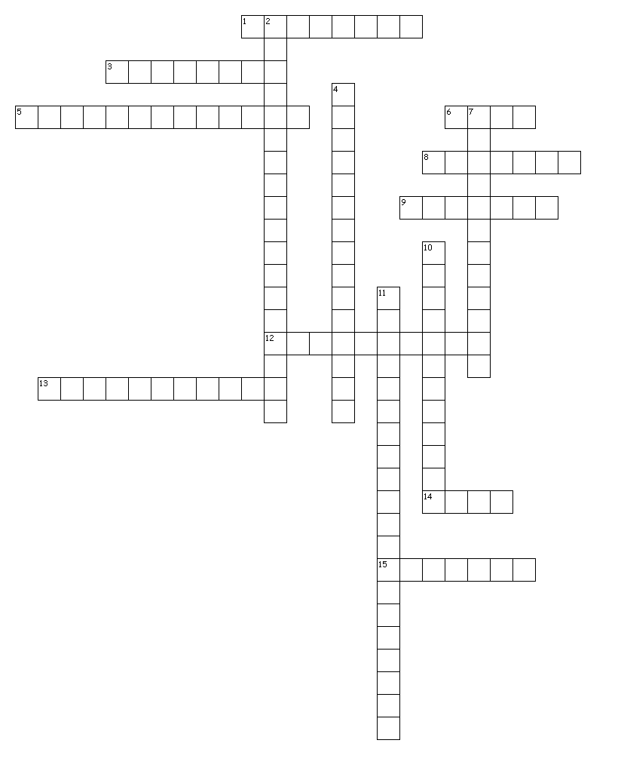
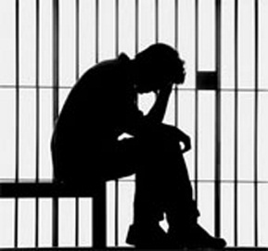
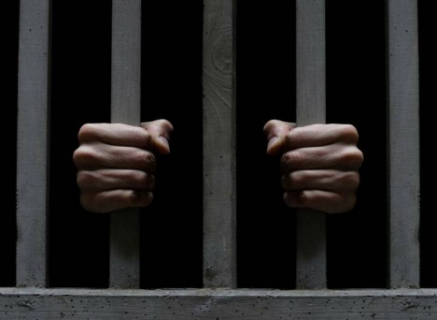
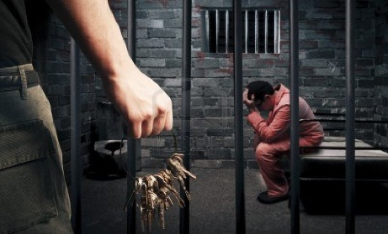
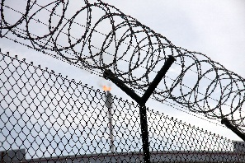
The psychological effects of custodial sentencing
Across
1. What happens to levels of anxiety and depression as the inmate adjusts to the situation?
3. Which psychologist famously studied the psychological effects of institutionalisation?
5. What process of socialisation develops in prisons and ranges from alterations in lifestyle such as eating and sleeping habits, to adopting prison slang and the acceptance of certain norms?
6. Approximately how many times more prevalent are suicide rates amongst prisoners than the general population?
8. Which psychologist argues that an inverted-U pattern exists whereby conformity to prison staff norms increases in the early stages and the late phases of the sentence, but dips in the middle?
9. In extreme cases, stress, anxiety and depression could lead to which additional psychological effect?
12. Two of the most common psychological effects of imprisonment are anxiety and ____
13. Anxiety and depression represent psychological responses to what process?
14. Institutionalisation is most likely to develop in which type of sentence?
15. Anxiety and depression are particularly prevalent early in the sentence which has been suggested may be the result of the removal of a person’s ____
Down
2. Zimbardo’s study may not reveal the psychological effects of imprisonment because the study is said to be lacking in this.
4. What type of prisons are more likely to increase stress levels as they contain hardened criminals with more extreme levels of violence and aggression?
7. What process within a prison brought about my lack of resources can increase stress levels, with prisoners being subjected to inhumane living conditions?
10. The long-term effects of imprisonment are unknown due to a lack of this type of psychological study.
11. What process occurs whereby the prisoner becomes enveloped in the roles associated with their environment?

Slide 25
Alternatives to custodial sentencing
THEORY
DESCRIPTION
Strengths
Limitations
Restorative justice
Electronic tagging

Slide 26
Behaviour modification
Behaviour modification involves the use of ­­­___________________________principles to ­­­___________________________undesirable behaviours and establish/promote desirable ones. The underpinning principle is that behaviours that are reinforced are ­­__________________________ whereas behaviours that are ­­­___________________________are weakened.
Behaviour modification can be implemented on an ­­­___________________________ level through the use of­­­_________________________________. In a typical token economy programme, the ­­­________________________________ draws up a list of behaviours they wish to promote known as ­­­___________________________ behaviours. These might include interacting ­­­__________________, complying with ­­­_________________________, completing ­­­__________________________ and so on. When an offender carries out one of the targeted behaviours they are given a token (also known as a ­­­___________________________). Tokens may later be ­­­___________________________ for ­­­___________________________ such as ­­­_______________________, ­­­_______________________, access to ­­­___________________________ etc. The rationale is that through _______________________­­_______, desirable behaviour will be encouraged and undesirable behaviour extinguished. In some schemes tokens may be taken away as a ­­­_____________________. Evidence regarding the effectiveness of token economies suggests that they have __________________________________ with young offenders (Hobbs & Holt, 1976) and adult offenders (Allyon & Milan, 1979). However, the improvements tend not to _____________________ beyond the institution in the longer term. Cohen and Filipcjak (1971) found a reduction in offending after two years but not after ­­­_____________________. Blackburn (1993) concludes that token economies principally make offenders easier to ­­­___________________________but they have little real ­­­___________________________ value. Additionally, the use of token economies raises ___________________________. In order to ensure that the tokens have reinforcement value, access to basic goods must be restricted. Arguments that this infringes the rights of the offenders have led to the closure of at least one such programme in the US (Nietzel, 1979).
Chores
Ethical issues
Exchanged
Extinguish
Generalise
Institutional
Institutional management
Manage
Operant conditioning
Positively
Primary reinforcers
Punished
Punishment
Rehabilitative
Rules
Secondary reinforcer
Selective reinforcement
Short term effectiveness
Strengthened
Sweets
Targeted
Television
Token economy programmes
Three
Trips out

Slide 27
Token economy quick quiz
What is the aim of a token economy programme?
Tokens are described as being secondary reinforcers. What does this mean?
What are ‘target behaviours’?
The tokens are exchanged for primary reinforcers. Give two examples of primary reinforcers.
Give one explanation for why individuals may lose their motivation to earn tokens.
How do staff assess whether or not the programme has been successful?
What is an ethical issue with TEP?
What empirical evidence is there for TEP being successful?
What term means the way offenders apply their newly learned positive target behaviours to the real world upon release from prison?
True or false? Token economies have shown some signs of reducing recidivism

Slide 28
Anger management multi-choice quiz
The number of stages that take place within anger management
The stage in which the individual is encouraged to learn more effective ways of dealing with their anger and the situations which cause it to erupt.
The type of situation in which anger management is normally completed
Within skills acquisition, which of the following is NOT an example of a cognitive skill?
One
Two
Three
Four
Cognitive preparation
Application practice
Behavioural acquisition
Skill acquisition
One to one sessions
Small groups
Paired work
Role play in large groups
Using breathing techniques
“Stop and think”
Counting
Rehearsing thoughts
Role play is commonly used as part of anger management strategies. In which stage does this take place?
A strength of anger management is that it teaches relaxation techniques to deal with these types of responses to anger.
This type of training can help deal with the issue of anger constructively, not violently and therefore is a useful application of anger management
The number of sessions which are generally required for anger management to be effective
Skills acquisition
Application practice
Cognitive preparation
Stage 2
Environmental
Cognitive
Physiological
Unconscious
Assertiveness
Relaxation
Preparedness
Acquisition
8
12
16
18

Slide 29
Some studies have shown the success of anger management programmes which largely use what type of data?
One of the advantages of anger management is:
A study in support of the effectiveness of anger management was conducted by:
The experimental and control groups in Ireland’s study contained how many Ps respectively?
Experimental
Self-report
Observation
Content analysis
There are contradictory findings from studies
Useful where anger is not already an established issue
Beneficial for non-violent crimes
It identifies what triggers crime so has long term benefits
Hobbs and Holt
Cullen and Seddon
Loza and Loza-Fanous
Ireland
50 and 50
50 and 47
50 and 37
50 and 35
Ireland’s study consisted of 12 anger management sessions which were provided over how many days?
The amount of prisoners in Ireland’s experimental group that benefitted from the intervention in terms of better scores on at least one of the measures was:
Which of the following is NOT an advantage of anger management?
One of the problems with Ireland having used self-report measures is:
One
Two
Three
Four
92%
98%
87%
96%
Makes prisoners more manageable when sessions are provided in an institution
Leads to increased recidivism rates
Changes understanding and not just behaviour
Has real-world application e.g. marital conflict
Objective
Unfalsifiable
Correlational so no causation
Demand characteristics

Slide 30
Hunter found that anger management could help to reduce
One of the key studies against the effectiveness of anger management was conducted by:
The country in which Loza and Loza-Fanou’s study took place
The research method used by Loza and Loza-Fanous
Impulsiveness
Depression
Interpersonal problems
All of the above
Dowden, Blanchette and Serin
Keen
Loza and Loza-Fanous
Dobash
Canada
USA
Australia
UK
Field experiment
Structured interviews
Questionnaires
Psychometric tests
The conclusion reached by Loza and Loza-Fanous was that there are no significant difference in:
Which of the following is a problem with anger management?
Some researchers have criticised the usefulness of anger management because:
Overall, the most effective form of treatment is considered to be:
Role play versus non-role play methods
Anger measures between violent and non-violent offenders
Recidivism rates of anger management and token economy systems
Anger and behavioural explanations of crime
It fails to eliminate angry behaviours entirely
It may lead to physical aggression turning into verbal or emotional abuse
It presupposes a link between anger and crime when one may not exist
All of the above
It encourages prisoners to deny responsibility
The benefits of reinforcement do not generalise beyond prison
Little rehabilitative value
Ethical issues inside the institution
Token economy systems
Anger management
Social skills training
Cognitive and behavioural therapies combined

Slide 31
Anger management strength or limitation?
Programmes could do more harm than good as they may encourage offenders to blame their actions on anger rather than take full responsibility.
Studies show the success of anger management programmes from self report data, which are likely to be valid as they come from prisoners themselves.
Hunter [1993] describes how the prison environment is unique and that, ‘‘subcultural expectations and rigid systems of prisoner management may reduce or mask program effectiveness.’’
The programmes do not include a discussion of morality or understanding from a victim’s point of view, which has been said to limit their success.
It has been claimed that they turn physical aggression into other ways of expressing aggression, such as verbal or emotional abuse.
Studies claiming success of the programmes often use self report data, where prisoners might give socially desirable responses in order to look good, therefore saying the groups were useful, or they might simply have enjoyed the sessions as a break from routine.
Many studies do not look into the future to predict recidivism rates following anger management.
The programmes focus on learning about triggers from angry episodes and give people the tools to control their anger in the future, so they should have long term benefits.
Differences in selection criteria for acceptance onto the course and variance in the research designs adopted, coupled with differences observed in course content, style, length, and outcome measures, make any direct comparison between studies difficult.
In the West, anger is often seen as ‘manly’ and glorified in the media but this is not so in the East where to become overtly angry is to ‘lose face’. There have been few cross-cultural studies to research whether anger underlies crime in other cultures.
Anger management may not be used for certain types of crime where anger isn’t an underlying factor in causing the crime (e.g. property crimes, controlled psychopathy, fraud)
Working with a larger group of people with violent tendencies can create a higher risk of a violent outburst within the class. This creates a danger to everyone involved with the class, including the other attendees and the class instructor
According to the Mayo Clinic, anger can have adverse health effects, including headaches, high blood pressure, digestive challenges and problems with sleep so anger management may help inmates with health problems.
Offenders can take part voluntarily. This increases the programme’s effectiveness, as offenders who take part voluntarily are usually more committed to the programme’s success. This is in contrast to other treatments, such as token economy, which are often enforced over an entire prison system meaning that it may not be successful in all cases.
Anger management only focuses upon cognitive and behavioural aspects of anger and ignores the possible role that physical factors such as an excessive amount of testosterone may have upon the individual.
Empirical evidence suggest that anger management programmes are at least effective in the short term.

Slide 32
AM
TEP
AM
TEP
Focuses on triggering events
Based on the principals of operant conditioning
Requires these to be desired by the inmates – the objects, activities or privileges they can access need to be meaningful if they are to provide motivation
Involves learning positive behaviours through reinforcement
Involves cognitive preparation
These secondary reinforcers have no intrinsic value themselves
A balance must be reached between being too difficult to earn and too easy – either will reduce motivation.
Individuals learn behavioural and cognitive coping strategies, such as relaxation
Prior to beginning the programme, each individual’s baseline behaviour should be assessed
Involves recognising and understanding how irrational thoughts affect behaviour
Anger management or TEP?
Offenders are usually put on this type of programme due to the nature of their crime or because of personal characteristics.
Based on cognitive-behavioural principles
Involves skill acquisition
There must be sufficient staff to see and respond immediately to behaviours and staff must do so consistently
Educates members in the benefits of controlling their behaviour
Based upon the idea that secondary reinforcers can be exchanged for primary reinforcers
Involves application and practice - individuals try out the skills in role plays
Involves practising skills in new situations
Progressively harder to earn so that the individuals become less reliant on them
Involves identifying risk situations to prepare for future experiences

Slide 33
Behaviour Modification
Anger Management
Outline
Evidence
Strengths
Limitations

Slide 34
Evaluating learning theory explanations of crime
1 A strength of the social learning theories explanations into offending is that it provides us with real-world application.
2 Observational studies involve watching and recording people’s behaviour. They often take place in artificial settings therefore they lack ecological validity. This is a limitation because the results from the study will not be generalisable to the real world.
3 Although this study indicates that role models and imitation play a part in a person’s criminal behaviour, this may not be the case in real life. The participants in the study were working class therefore they were earning an income which is considered a reinforcement. Therefore, the participants may have performed criminal acts due to their own decision making and not because of family criminality. This also suggests that the research could be taken as evidence for a genetic theory of offending, since a high percentage of the sample had biological parents who were criminals, thus disregarding the learning theories.
4 The social learning theory therefore has allowed us to understand how violence in the media can change the behaviour of young children and that by allowing children to watch aggression you are allowing them to imitate the behaviour which can them influence them to perform criminal acts.
5 This is supported by Osborne and West’s study who found that where the father had a criminal conviction, 40% of sons also acquired one by the age of 18, compared with only 13% of the sons of non-criminal fathers.
6 By having this real world application means that we are able to lower levels of aggression by protecting children from violence in the media e.g. TV and video games which could ultimately lower crime rates.
7 Sutherland stated that the basic prediction of differential association theory is that people who become offenders will have been socialized in families and group where there are some pro-criminal norms; There should therefore be evidence of pro-criminal norms and probably criminal activity in the families and peer groups of offenders. This idea of pro-criminal norms disregards all other theories to offending such as the biological explanations as Sutherland argues that if a child acquires more attitudes that are favourable to crime than unfavourable ones, the result will be that they regard criminal behaviour as acceptable.
8 A limitation of the learning theories of offending is that in order to assess a change in behaviour in terms of aggression due to reinforcement, observational studies must be carried out.
9 A strength of the learning theories of offending is that there is some evidence to support the idea of pro-criminal values within families as people with criminal parents run a higher risk of becoming criminals themselves.
10 It is well known in our society that criminals are frequently caught and imprisoned, a fairly salient observed punishment. It is also the case that most people work in legitimate employment to acquire reinforcements such as money and status, another very obvious set of models and observed reinforcements. This being the case it is not clear why people behave criminally at all if the vast majority of models and reinforcements should promote non-criminal behaviour.
11 Although this study showed that children imitate aggression from models which could also lead to criminal behaviours being imitated, the study’s findings cannot be generalised to the real world. The method relies on research conducted in artificial settings therefore behaviour observed may not be reliable and that the children in Bandura’s study may have acted differently as they were influenced by demand characteristics. In real life, the children may respond differently towards humans than the way they responded towards the Bobo doll.
12 This therefore provides empirical evidence that a child may perform criminal acts based on the acceptance of their parents’ pro-criminal views.
13 For example, Bandura used the experimental observation method to investigate the role of models in aggression. He tested 72 children half male half female who were divided into groups who watched an aggressive or non-aggressive model play with a bobo doll. The model was either the same or different sex. The children were then taken separately to an experimental room and were allowed to play with the bobo doll. The observers rated the children for how much they displayed evidence of imitating aggression or non-aggression. The results showed that the children would imitate the behaviour they saw, although the likelihood of modelling depended on the characteristics of the model and whether they were seen to be a reward or punishment.
14 For example, Farrington et al carried out the Cambridge Study of Delinquent Development, a longitudinal study. A group of 411 working-class boys and their families, from a deprived inner-city area of south London, were studied from the age of 8 years in 1961 to the age of 50 years. Researchers recorded details of family background, parenting styles and school behaviour. They also recorded the rate and type of convictions at various points. 41% of the sample were found to have had criminal convictions between the ages of 10 and 50 years.
15 A limitation of the learning theories of offending is that it underplays the role of cognitive factors, such as decision making, in criminal behaviour.
16 For example, the Columbine massacre in which the two boys involved in the murder of 13 students and teachers and wounding of 23 others before committing suicide were said to have been avid players of the computer game Doom; a game licensed in the US military to train soldiers to effectively kill. The boys had created a video a year before this event in which they acted out the game wearing trench coats and carrying weapons. This would suggest that the theory indicating that violence in the media can cause criminal behaviour in young children has real world application.
1
4
16
6
8
2
13
11
9
7
5
12
15
10
14
3

