Slide 1
Final education topic
Educational Policy and Inequality

Slide 2
What is educational policy?
'Educational policy' r
efers to the plans
for education introduced by government, through
Acts of Parliament, together with instructions and recommendations to
schools and local authorities.
For example
the 2010 Academies Act
which allowed all state sc
hools to become academies.
Economic efficiency
Raising educational standards
Creating equality of educational opportunity in a meritocratic society

Slide 3
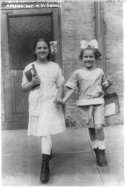
What was education like in the UK in the past?
Until the 19th century, the state spent no public money on education; education was available only to the small minority who could afford to send their children to fee paying schools or where charities or churches set up their own schools.
In 1891 elementary education became free to all and in 1918 the leaving age rose to 14. However, schooling did little to alter people’s ascribed status: working class were only educated to a basic level in literacy and numeracy

Slide 4
Then what happened? Tripartite Education system remember tripartite means 3 bits
Read page 77 and fill in the box that looks like this
Butlers Education Act 1944... read page 77 and explain how the tripartite system and selection changed education

Slide 5
Your answer should say something like…..
Education began to be influenced by the idea of meritocracy
Children were to be sent to 3 different types of schools based on their skills and ability.
They took 11+ exams to see how clever they were.
1. The cleverest would go to grammar schools, they would study an academic curriculum. Pupils in these schools were mainly middle class.
2. The others went to Secondary Modern
3. There was a 3rd type of school called a technical school but these were actually quite unusual.

Slide 6
Good system? Evaluation of the Tripartite System
Maybe did allow for meritocracy?
Made schooling dependent on ability?
But reproduced class inequality by making the two social classes go to two difference types of school that offered unequal opportunities. Grammar schools, attended by only 20% (mostly attended by middle-class), were seen as the most prestigious type of school as it taught academic subjects that led to university and well-paid jobs. However, the 75% of pupils who attended secondary moderns (mostly working-class) were seen as 'failures'. Some were not allowed to take exams, so were denied opportunities to progress.
The system also reproduced gender inequality by requiring girls to gain higher marks than boys in the 11+ to obtain a grammar school place, as there were fewer girls' grammar school places.
The tripartite system also legitimated (justified) inequality through ideology that ability is inborn. It was thus argued that ability could be measured early on in life, through the 11+. However, in reality children's environment greatly affects their chances of success.
For most pupils only two types of school were available - grammar and secondary moderns. Few technical schools were built because of the cost of equipping them.
A number of reports (Crowther Report, 1959) suggested that a lot of working-class talent was being wasted (by placing them in secondary moderns) and the system was producing too few skilled workers.

Slide 7
As the tripartite system did not succeed in creating equality of opportunity (tackle class divide) Comprehensive Schools were introduced to overcome the class divide.
Read top of page 78 and complete the table which looks like this….
Strengths | Weaknesses
Functionalists would say | But Marxists would say

Slide 8
Comprehensives, evaluation
Functionalists comprehensives are good for society, they bring children from different classes together (BUT other studies have found that within a comprehensive middle class children socialist with middle class children etc)
Functionalists also think that pupils have longer to prove themselves in this system so it is more meritocratic.
Marxists argue that comprehensives are not meritocratic. Class inequality is just reproduced in these schools through streaming and labelling. Remember the ‘myth’ or meritocracy where school looks fair and just but the working class struggle to keep up.

Slide 9
What happened after 1988 - Marketisation
Marketisation refers to the process of introducing market forces of consumer choice and competition between suppliers into areas run by the state, such as education. Marketisation has created an 'education market' by:
reducing direct state control over education
increasing both competition between schools and parental choice school.

Slide 10
The New Right favour marketisation. Why does the New Right favour marketisation policies?
Schools have to attract customers by competing and provide customers with what they want (success in exams). The New Right favour this as they think this motivates schools to get better.

Slide 11
Marketisation - Parentocracy
Miriam David 1993 describes marketized education as ‘parentocracy’ – meaning rule by parents. Power shifts from producers (teachers and school) to the consumers (parents). Tis gives more choice and raises standards.
Read page 78 and give some examples of policies which promote marketisation.

Slide 12
Policies which promote marketisation
Business ownership of schools.
Open enrolment
Schools being allowed to become academies
Competition
Tuition fees
Parents being allowed to set up schools.

Slide 13
BUT Ball and Whitty claim marketisation has actually made inequality worse as methods such as league tables reproduce class inequality as this creates inequality between schools. Remember – if some schools are better than others this gives middle class parents the chance to get their kids into the better schools.
Ball alsd claims that ‘parentocracy’ is a myth as not all parents have the same freedom of choice about where to send their children.

Slide 14
If exam results are published good schools become more in demand.
Explain what Will Bartlett (1993) says about this.
Cream skimming
Silt shifting

Slide 15
Explain what Will Bartlett (1993) says about this.
Cream skimming
Good schools can be more selective and get the best. These are mainly middle class kids who then have an advantage
Silt shifting Good schools can avoid taking less able pupils who are likely to get bad results

Slide 16
Schools are allocated funding based on how many pupils they attract. Popular schools get more money and get better then may get more selective and be able to afford more experienced teachers.
What did the study in 2012 of international patterns of educational inequality find?

Slide 17
What did the study in 2012 of international patterns of educational inequality find?
This study found that competition-orientated systems like Britain produce more separation between children of different social backgrounds.

Slide 18
More about parents Gewirtz
Studied 14 London Secondary Schools. Found that differences in economic and social capital had a big impact on school choices.
She found 3 types of parent
Priveleged – skilled choosers
Disconnected – local choosers
Semi-skilled choosers.

Slide 19
Priveleged – skilled choosers
Professional
Confident and well educated.
Can use economic and cultural capital well
Cultural capital – they had an understanding of school admissions, time to visit and ability to research
Economic capital – can afford school fees or to buy a house in the right area, or to pay for the school bus so children can travel to a better school.
This Photo by Unknown Author is licensed under CC BY-NC

Slide 20
Disconnected – local choosers
Working class parents
Sent children to local school
Did not understand admissions procedures and not aware of their choices.
Funds were limited so cost of travel could be a barrier so nearest school most realistic option.

Slide 21
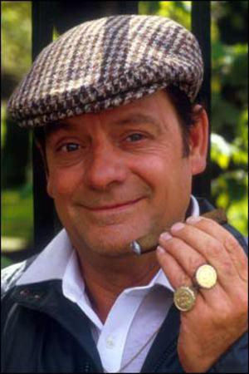
Semi-skilled choosers
Mainly working class but ambitious.
But often lacked cultural capital to make sense of the education market
So in theory everyone has a choice but Gewirtz has shown it there are a wider range of choices for middle class parents. s
This Photo by Unknown Author is licensed under CC BY-NC

Slide 22
Holiday work
Relax and catch up on some Sociology documentaries. Use this link and focus on the education ones.
https://hecticteachersalevelsociologysite.wordpress.com/documentaries/education/

Slide 23
SO we have thought about parentocracy, remember these guys?
Is this a good thing?
Ball is concerned that by giving parents more power, parents of advantaged children will get more benefits as they can manipulate the system and other pupils will lose even more ground.

Slide 24
This cartoons shows the advantage parents with cultural capital may have.

Slide 25
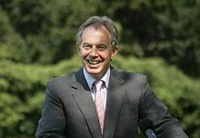
1997 – 2000 New labor
While Marketisation policies tended to increase inequality, the New Labour governments of 1997 to 2010 also introduced a number of policies aimed at reducing it.
Examples - Education Action Zones.
The Aim Higher programme to raise aspirations of groups who were under-represented in higher education.
Educational Maintenance Allowance (EMA):
Introduction of the National Literacy Strategy, literacy and numeracy hours, and reducing primary school class sizes. It is claimed these policies are of greater benefit to disadvantaged groups and so help to reduce inequality.
City academies
Increased funding for state education and higher education (grants for universities for low-income families).
Tuition fees labour introduced these to pay for expanding universities and to try and offer more places so disadvantages pupils could access university.
BUT research has suggested that pupils from deprived families struggled more because of the cost attached to going to university so were less likely to.
This Photo by Unknown Author is licensed under CC BY-SA
This Photo by Unknown Author is licensed under CC BY-NC

Slide 26
Coalition 2010 onwards
‘excellence, competition and innovation’ by freeing schools from the ‘dead hand of the state’
The Conservative-Liberal Democrat Coalition government elected in 2010 speeded up the move away from an education system based largely on comprehensive schools run by local authorities. Its policies have been strongly influenced by the New Right ideas of reducing the role of state in the provision of education through marketisation and privatisation. Through policies such as academies and free schools. They also increased tuition fees for universities.
This Photo by Unknown Author is licensed under CC BY-NC

Slide 27
Academies and Free schools
Read p81 and fill in your chart on page 11 of the booklet.

Slide 28
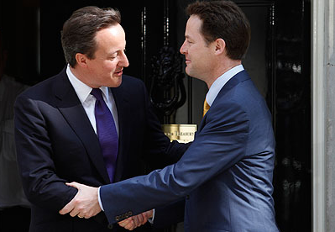
How did the coalition try to tackle inequality?
Free school meals
Pupil premium
This Photo by Unknown Author is licensed under CC BY-NC-ND
This Photo by Unknown Author is licensed under CC BY-ND

Slide 29
Evaluation (see p82)
Was pupil premium effective? Ofsted?
Austerity programme? Spending cuts, EMA gone, tuition fee tripled, sure start centres shut.

Slide 30
Privatisation of areas of schooling.
P 82 for a definition
Examples?
ESI = ‘educational services industry’
Private companies are used to build schools, provide supply teachers etc.
Building companies often set up very profitable contracts with authorities which can be 25 year contracts. These also are very profitable. Some companies make up to 10 times what they would make on other projects but local authorities are obliged to enter into these agreements as there is not central government funding available.
Many senior officials like advisors and Headteachers have left education to set up consultancy companies and private sector education businesses.

Slide 31
Advantages of privatisation | Disadvantages of privatisation
Where there is competition for contracts some believe this can raise standards and local authorities can shop around. | Free schools have not improved standards. Rise in tuition fees has not increased places at universities When things are privatised there is no central control so this can lead to improvements or to reduction in quality. There have been examples of corruption in Academies with headteachers not managing budgets, paying themselves inflated salaries etc

Slide 32
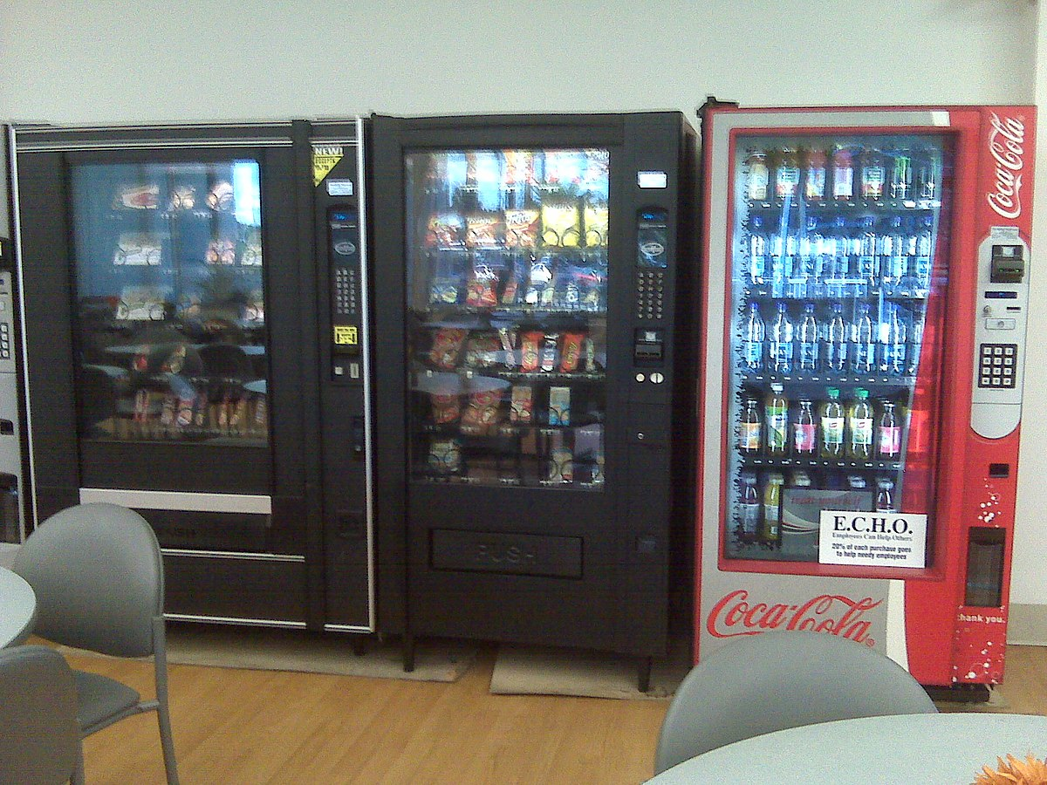
Globalisation of education and cola-isation of schools
Read p 82 and 83 for examples
This Photo by Unknown Author is licensed under CC BY-SA
This Photo by Unknown Author is licensed under CC BY-SA
This Photo by Unknown Author is licensed under CC BY-SA

Slide 33
Evaluation of privatisation in education.
As education becomes more of a commodity the state loses more control BALL ‘more and more areas of education are now subject to business practices…..the ratcheting up of policy over time opens up more education services for profit’
Hall agrees as a Marxist and says that as public services are handed over to private capitalists the driving up of standards is a myth to legitimise turning education into a source of private profit.

Slide 34
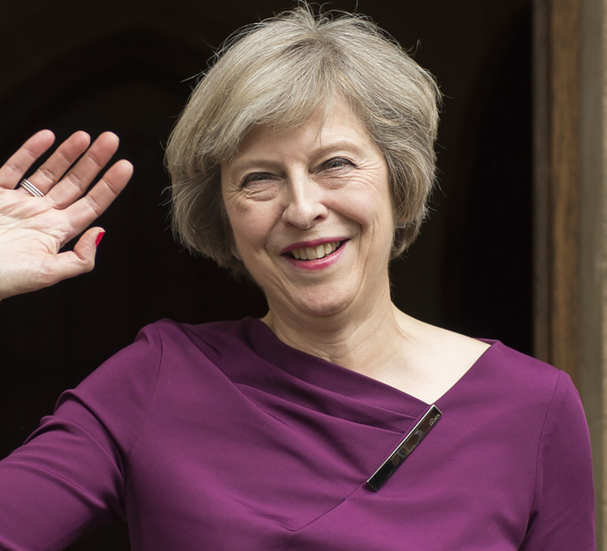
Theresa May and Grammar schools
Idea based on meticracy
Did not happen.
This Photo by Unknown Author is licensed under CC BY-ND

Slide 35
How does ecucational policy aim to fix gender and enthnicity inequality?

Slide 36
Evaluation of educational policy which tries to tackle inequality – all these names are on the syllabus
Douglas 1964, 1970 carried out a long term study looking at social class and education. In 1946 he selected 5362 British children who were born in the first week of March, he followed their educational careers until 1962. He divided them up in terms of ability (measured by IQ tests) and divided them up in terms of social class. He found that in the ‘high ability’ group 50 % of pupils from the lower working class left secondary school at the end of year 11, compared to 33 % from upper working class and 10% from the upper middle class. He concluded that the single most important factor in this was parents’ interest in their children’s education. More visits to school, conversations with teachers and primary socialisation which is more stimulating.
Nel Keddie looked at the ‘myth of cultural deprivation’ showing that cultural deprivation may not be an explanation for working class underachievement. She believed that children from low income families are seen by teachers as ‘uneducable’ as teachers have soaked up this myth so may be labelled by staff perceptions rather than by external factors.
Becky Francis studied the classroom and found that school is gendered, girls get less attention from teachers, boys are more aggressive in the playground and may dominate space. Poligies to encourage girls to choose science etc may not be able to tackle this larger cultural problem.
Tony Sewell looked at black pupils and external reasons for underachievement such as peer group anti-education subcultures and gangs and single parent families so multicultural education policies may not help. Also teachers were found to single out black pupils for punishment more often so we can see that the policies above may not target these problems.
Mirza looks at the myth of black female underachievement. She found that black women are often underestimated and that they often achieve well and have high self esteem.

Slide 37
Please complete p19 as a summary

