Slide 1
GCSE Computer Science (9-1)
Programming
Lesson 5: classification of languages

Slide 2
Lesson Objectives
Explain the main differences between low-level and high-level languages.
Know that machine code and assembly language are considered to be low-level languages and explain the differences between them.
Understand that ultimately all programming code written in high-level or assembly languages must be translated into machine code. Understand that machine code is expressed in binary and is specific to a processor or family of processors.
Understand the advantages and disadvantages of low-level language programming compared with high-level language programming.
Understand that there are three common types of program translator: Explain the main differences between these three types of translator. Understand when it would be appropriate to use each type of translator.

Slide 3
How do computers think?
Starter:
“ A computer can think ”
How far do you agree/disagree with this statement?

Slide 4
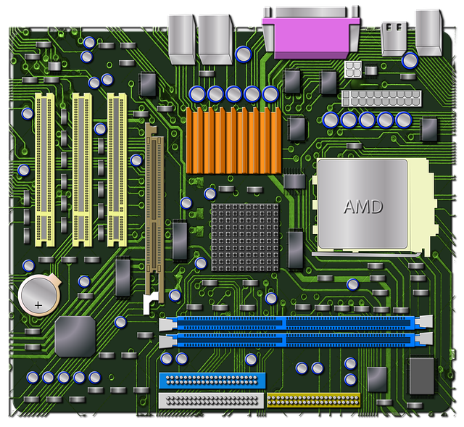
What is a computer?
Once you strip away the software, the peripherals, all the physical casings, you’re left with a motherboard and a processor
This is what we consider to be our computer
So – a computer is a bit of technology powered by electricity

Slide 5
Computer instructions
Computers cannot understand raw instructions in a programming language such as OUTPUT, USERINPUT, FOR X ← Y TO Z
Computer instructions use binary because computers fundamentally understand two states: on and off (positive and negative voltage)
This means that computers can use instructions based on simple logic diagrams and circuits (which you will learn about in Unit 4)

Slide 6
Machine Code
When computers were first programmable, instructions were written in binary
It would also use up one line for one instruction, whereas one line in a modern language carries out multiple!
Subsequently, programming was very tedious, lengthy and time consuming!

Slide 7
Low Level Languages
Computers can only understand instructions written in low-level languages
A low level language is comprised of binary bit patterns, representing one instruction per bit pattern
These instructions use opcodes and operands – the first half of a byte for an operation, the second half being the data used
Computers can use these binary instructions so that they can be based off of logic circuits representing on/off

Slide 8
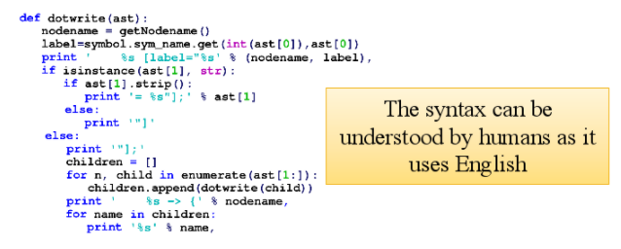
High Level Languages
High Level code is a program written in syntax using English notation, which is easier for a human to understand
We use software nowadays using High Level Languages

Slide 9
Features of High Level Languages
Multiple instructions per statement
Written in English notation
Uses in-built functions and methods
Independent syntax for each language

Slide 10
Comparing High-Level and Low-Level Code
Here is an example from AQA of a high-level and a low-level program
Notice the differences?

Slide 11
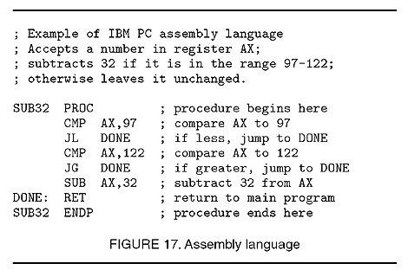
Assembly Language
Another example of a low level language is assembly language
This is comprised of mneumonics, which are translated into binary

Slide 12
Consider
Source Code
???
Machine Code
Low level languages enable a computer to understand a program.
How can we convert high level code into low level code?

Slide 13
Converting Code
Source Code
Translator
Machine Code
To interconvert low level and high level languages, we use translators
These convert our high-level programs into instruction sets for the CPU to execute, either as machine code or assembly language
All programs have to be translated into machine code before they can be executed.
There are three types: interpreters, compilers and assemblers

Slide 14
Now watch this video!
Machine Code and High level Languages Using Interpreters and Compilers
https://www.youtube.com/watch?v=1OukpDfsuXE

Slide 15
Interpreters
Interpreters read the first instruction, translates it and executes it
This repeats throughout the program – and so on, and so forth
Interpreters translate each instruction one-by-one, thus interpreters are considered slower
But, the interpreter is constantly between you and the computer whilst communicating
Interpreters also allow easier troubleshooting for a program

Slide 16
Compilers
Compilers take the complete set of instructions and translate the whole lot into low level language – it compiles the entire program!
This is considered to be a lot faster as instructions are executed all in one go
However, instructions cannot be troubleshooted

Slide 17
Assemblers
Assemblers are used to translate assembly code mneumonics into machine code, so that they can be executed
Why use assembly language?
Assembly language uses mneumonic instructions, such as STA ADD SUB – these can be understood easier than binary opcodes and operands

Slide 18
Tasks
Complete the worksheet on classifying languages

