Slide 1
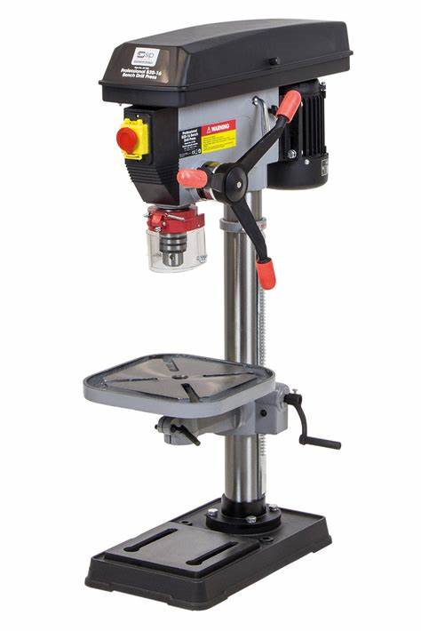
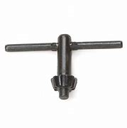
Design Technology
Emergency Stop button
Adjustment Lever
Chuck
Pillar Drill
Guard
Table
Chuck Key
Column

Slide 2
Design Technology
Pillar Drill

