Slide 1
Quick Quiz
1 Pressure in a container full of gas is caused by:
A particles sticking to the walls.
B particles bumping into the walls.
C particles sticking to each other.
D particles falling to the bottom of the container.

Slide 2
Quick Quiz answers
7Ge
1 Pressure in a container full of gas is caused by:
A particles sticking to the walls.
B particles bumping into the walls.
C particles sticking to each other.
D particles falling to the bottom of the container.

Slide 3
Quick Quiz
2 You can increase the pressure in a container full of gas by:
A making the container smaller.
B making the container bigger.
C cooling the gas.
D taking some of the gas out.

Slide 4
Quick Quiz answers
2 You can increase the pressure in a container full of gas by:
A making the container smaller.
B making the container bigger.
C cooling the gas.
D taking some of the gas out.

Slide 5
Quick Quiz
3 If you put more gas into a container the pressure increases because:
A the particles all cool down.
B there is more space for the particles to move around.
C more particles fall to the bottom of the container.
D there are more particles, so there are more collisions with the wall.

Slide 6
Quick Quiz answers
3 If you put more gas into a container the pressure increases because:
A the particles all cool down.
B there is more space for the particles to move around.
C more particles fall to the bottom of the container.
D there are more particles, so there are more collisions with the wall.

Slide 7
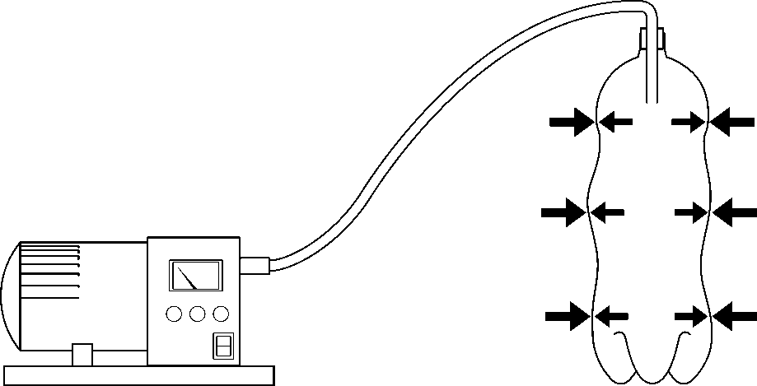
Quick Quiz
4 The air is being sucked out of this bottle. Why is it collapsing?
A There is more air pressure inside than outside.
B There is more air pressure outside than inside.
C There are more particles inside it.
D Air particles are sticking to the walls and pulling them in.

Slide 8
Quick Quiz answers
4 The air is being sucked out of this bottle. Why is it collapsing?
A There is more air pressure inside than outside.
B There is more air pressure outside than inside.
C There are more particles inside it.
D Air particles are sticking to the walls and pulling them in.

