Slide 1
Assessing non-financial performance (2)
Kaplan and Norton’s Balanced Scorecard

Slide 2
What theories are there about assessing non-financial performance?
There are 2:
Kaplan and Norton’s Balanced Scorecard
Elkington’s Triple Bottom Line
This presentation looks at the Balanced Scorecard

Slide 3
The Balanced Scorecard
The Balanced Scorecard looks at performance from 4 different angles or perspectives.
Financial performance is one of these but it is considered alongside the others as equally important
As you can see from this diagram there 4 perspectives are:
Financial
Internal processes
Learning and growth
Customer
Balanced Scorecard Video

Slide 4
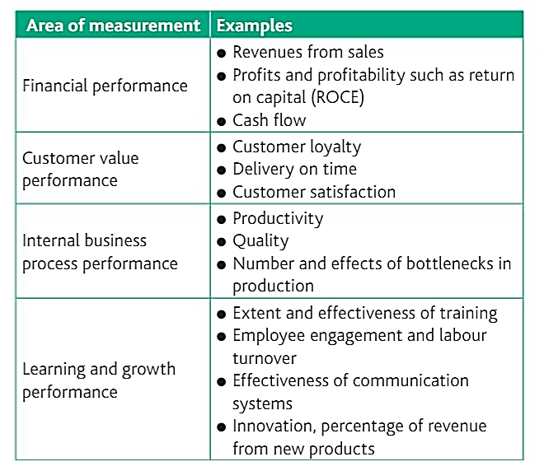
Ultimately, the balanced scorecard is still very data driven.
These measures are key performance indicators (KPIs) and are based on quantitative data which can be collected and assessed
Examples of the criteria / data which may be looked at for the balance scorecard

Slide 5
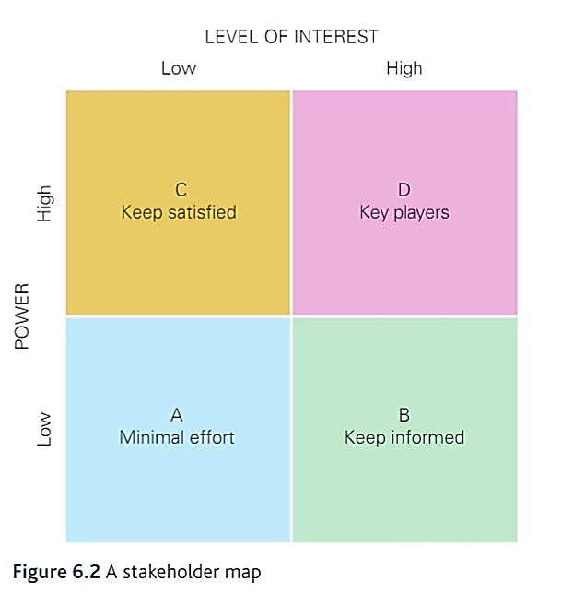
The Balanced Scorecard links really well to stakeholder mapping.
Think about how the different categories affect each other and how this would differ between firms.
In Greggs PLC, who would be a key player stakeholder group and what would they most interested in on the balanced scorecard?
What about in Ryanair Holdings PLC? How would the key players and their interest in the Scorecard be different?

Slide 6
Examples in the real world
One firm which uses this in practice is Tesco, they don’t call it the scorecard, they call it the big 6. Video: Tesco big 6
Sainsbury’s has a similar vision shown here:
- Note that neither of these firms calls it “The Balanced Scorecard” - this may happen in an exam; you have to recognise it.

Slide 7
Using the Balanced scorecard in exams
This is useful topic because you can talk about firms who are not performing well financially but might be achieving a lot of success in other ways.
Some organisations e.g. West Yorkshire Playhouse, St Gemma’s Hospice or Yorkshire Water are not focussed solely on making profits so need to be able to point to other measures of their success for their stakeholders.
Over the last 20 years the focus of business success has shifted significantly from just looking at profits to looking at the overall nature of business strategy and there is far more emphasis on firms not solely pursuing financial success at any price.
The extent to which this is important depends on the nature of the business and the relative importance of different stakeholder groups.

Slide 8
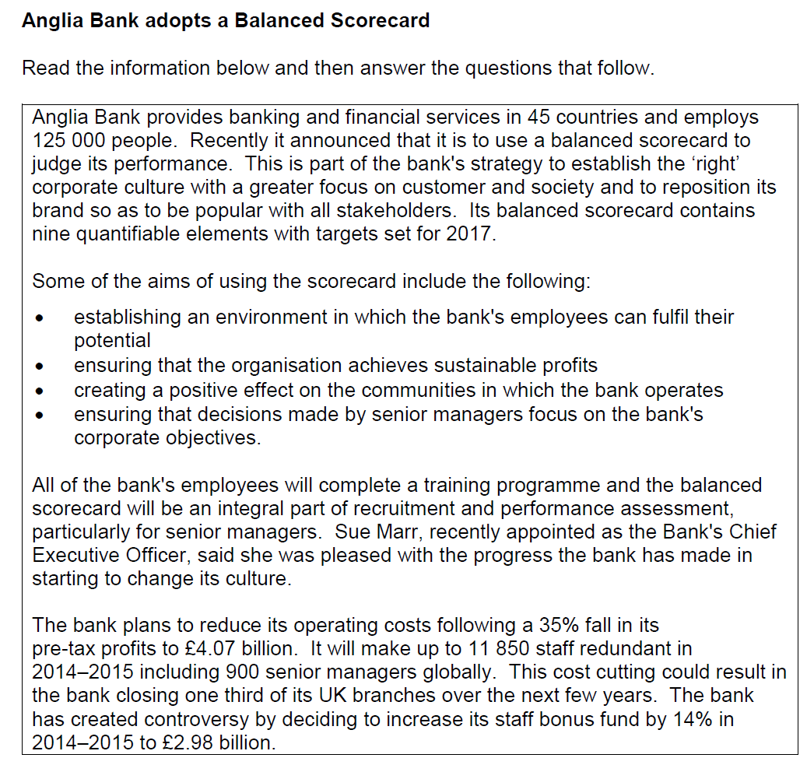
Do you think that all businesses should use a balanced scorecard to improve their strategic decision making? Justify your view. [16 marks] Specimen paper set 2, paper 2 Q2.3

