Slide 1
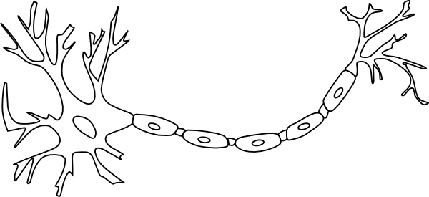
Neurons
Name the types of neuron below and describe their functions
Add the following labels to the diagram:
Colour:
The cell body – red
Dendrites - pink
The nucleus – orange
Myelin sheath – yellow
Nodes of Ranvier – green
Schwann cells – blue
Synaptic terminal - purple
Synapse
Dendrites
Nucleus
Nodes of Ranvier
Schwann cells
Synaptic terminal
Axon
Cell body

Slide 2
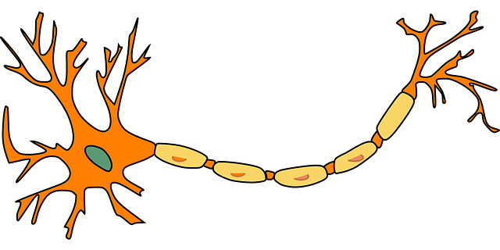
Neuron structure quiz
Answer the clues below and then label these features on the diagram of the neuron
Part of the neuron that releases neurotransmitters into the synaptic cleft
Fatty material that insulates the neuron enabling faster transmission
Takes information away from the cell body
The segments in the myelin sheath
The part of the neuron that contains the nucleus
Takes information to the cell body
The organelle in the neuron that contains genetic material
Produce myelin
The gap separating two neurons

Slide 3
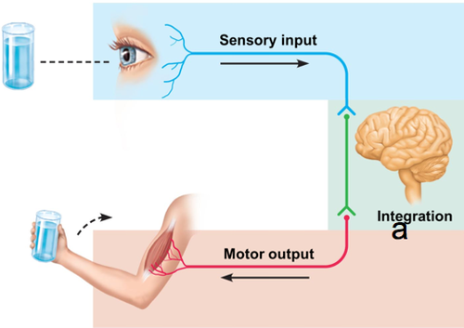
Types of neurons
Describe what is happening in this diagram using as much psychological vocabulary as possible.

Slide 4
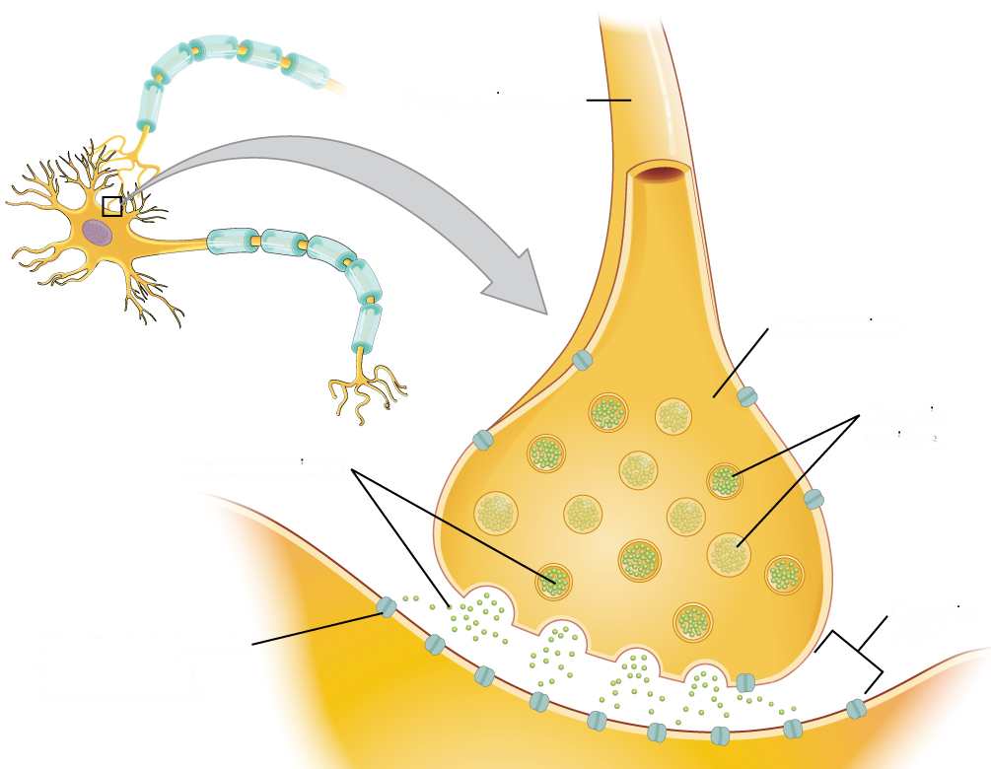
Neurons and synaptic transmission
Action potential (post-synaptic neuron)
Action potential (pre-synaptic neuron)
Calcium channels
Cell body
Dendrites
Myelin sheath
Neurotransmitter
Nodes of Ranvier
Nucleus
Post-synaptic neuron
Pre-synaptic neuron
Receptor
Synapse
Synaptic terminal
Synaptic vesicles
A
O
B
C
N
M
L
D
K
E
J
F
I
H
G

Slide 5
Synaptic transmission
This triggers the nerve-ending of the pre-synaptic neuron to release chemical messengers called neurotransmitters.
1
2
3
4
5
The receptor molecules on the second neuron bind only to the specific chemicals released from the first neuron. This stimulates the second neuron to transmit the electrical impulse.
Reuptake: the neurotransmitter is reabsorbed in the vesicles of the pre-synaptic neuron after it has performed its function of transmitting a neural impulse.
An electrical impulse travels along the axon of the transmitting neuron.
These chemicals diffuse across the synapse (the gap) and bind with receptor molecules on the membrane of the next neuron.

Slide 6
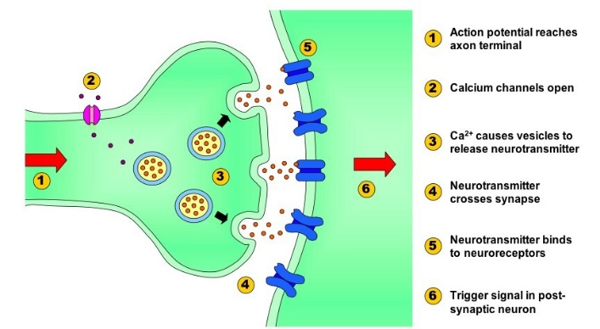
Synaptic transmission missing blanks
Neurons communicate with each other within groups known as ­­­­­­­­­____________________. Each neuron is separated from the next by a tiny gap called the ____________________. Signals within neurons are transmitted ____________________ (the positive charge inside the neuron is called the ____________________) however, signals between the neurons are transmitted ____________________ across the synapse.
When the electrical impulse reaches the end of the neuron (the ____________________), it triggers the release of ____________________ e.g. acetylcholine from tiny sacs called ____________________. Neurotransmitters are ____________________ that diffuse across the synapse to the next neuron in the chain (the ____________________).
Once the neurotransmitter crosses the gap, it is taken up by the post-synaptic ____________________– in other words, the ____________________ of the next neuron. Here, the chemical message is converted back into an electrical impulse and the process of ____________________ begins again in this other neuron with an action potential being fired. This whole process is known as ____________________.
Several dozen types of neurotransmitter have been identified in the ____________________ (as well as the spinal cord and some glands). Each neurotransmitter has its own specific ____________________ structure that fits perfectly into a postsynaptic receptor site (similar to a lock and key). Neurotransmitters also have specialist functions. For instance, ____________________ (ACh) is found at each point where a motor neuron meets a ____________________ and upon its release, it will cause muscles to ____________________.
Neurotransmitters have either an ____________________ or ____________________ effect upon a neighbouring neuron. For instance, the neurotransmitter ____________________ causes inhibition in the receiving neuron, resulting in the neuron becoming more ____________________ charged and less likely to fire. In contrast, ____________________ (an element of the stress response which is both a hormone and a neurotransmitter) causes excitation of the post-synaptic neuron by increasing its ____________________ charge and making it more likely to fire.
ACETYLCHOLINE
ACTION POTENTIAL
ADRENALINE
BRAIN
CHEMICALLY
CHEMICALS
CONTRACT
DENDRITES
ELECTRONICALLY
EXCITATORY
INHIBITORY
MOLECULAR
MUSCLE
NEGATIVELY
NEURAL NETWORKS
NEUROTRANSMITTER
POSITIVE
POST-SYNAPTIC NEURON
PRESYNAPTIC TERMINAL
RECEPTOR SITE
SEROTONIN
SYNAPSE
SYNAPTIC TRANSMISSION
SYNAPTIC VESICLES
TRANSMISSION

Slide 7
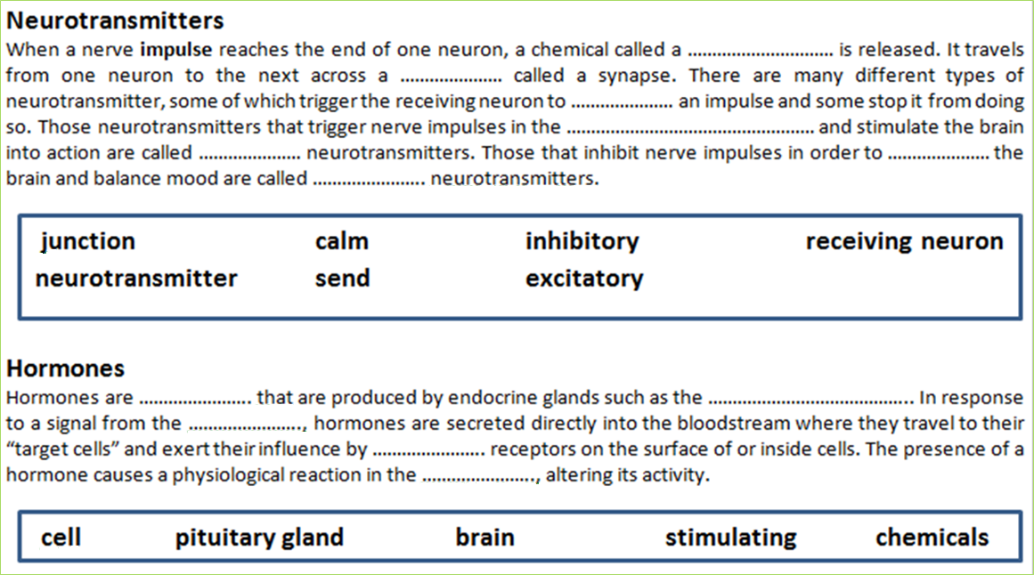
Neurotransmitters and Hormones

Slide 8
The nervous system
The human nervous system
What are the names and functions of each of the parts of the nervous system?

Slide 9
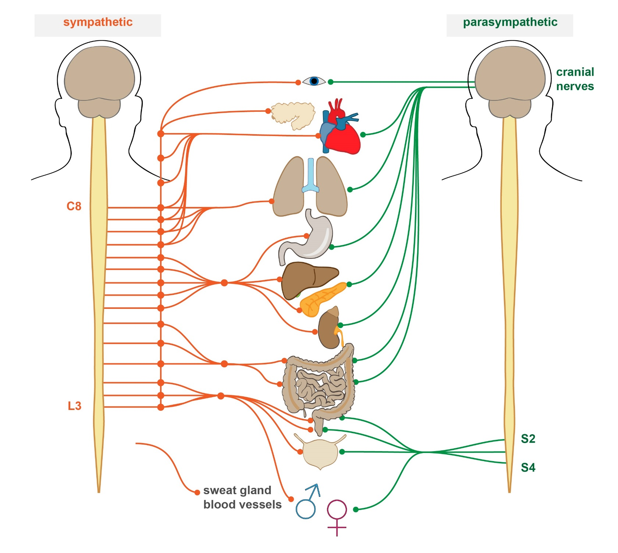
Branches of the ANS: sympathetic and parasympathetic nervous systems
The sympathetic nervous system…
The parasympathetic nervous system…

Slide 10
Billy is an A level student. He has been asked by his teacher to give a short presentation to the other psychology students in his class. Just before his presentation, Billy feels his mouth go dry and he starts to sweat. After the presentation has ended, Billy feels his breathing slow down and he begins to feel thirsty.
Use you knowledge of the autonomic nervous system to explain Billy’s behaviour before and after the presentation.

Slide 11
Fight or flight
Clare was telling her friend Rachel the following story:
“I was walking home by myself in the dark. Suddenly, I heard a shuffling noise behind me. I realised it was coming closer. I saw a bus at the bus stop and decided to run. I could hear the footsteps getting closer. I don’t think I ever moved so quickly. I leapt on the bus shaking and sweating with my heart beating so fast. I turned to see an empty street as the bus pulled away. Had I imagined it?”
Outline the role of the CNS and ANS in behaviour referring to Clare’s experience in your answer.
Place numbers in the circles to show the correct sequence of events
This generates the fight or flight response
The pituitary gland releases ACTH
The adrenal glands release adrenaline into the bloodstream
The ANS changes from its normal resting state (parasympathetic nervous system) to the physiologically aroused sympathetic state
The threat passes and the parasympathetic nervous system returns the body to its resting state.
ACTH has an effect on the adrenal gland
Adrenaline causes physiological changes

Slide 12
The endocrine system
Label the parts of the endocrine system
Gland | Hormone | Target organ | Function
Adrenal
Pituitary
Ovaries
Pancreas

Slide 13
Identify and describe two glands of the endocrine system (4 marks)
Briefly outline two hormones and explain the function of each of these (4 marks)
Using an example, explain what is meant by the fight or flight response (3 marks)
Explain how the endocrine system and the ANS work together in the fight or flight response. (4 marks)

Slide 14
Multi-choice quiz
Which division of the nervous system is divided into sympathetic and parasympathetic branches?
Which describes the somatic nervous system?
The master endocrine gland is the…
Which is NOT an action of the parasympathetic branch of the ANS?
A The Central nervous system
B The peripheral nervous system
C The somatic nervous system
D The autonomic nervous system
A maintains homeostasis by regulating body temperature, heartbeat etc.
B Made up of the brain and spinal cord
C Controls muscle movement
D Passes messages to and from the brain and connects nerves to the PNS
A Adrenal gland
B Pituitary gland
C Thyroid gland
D Hypothalamus
A Inhibits digestion
B Contracts pupils
C Stimulates saliva production
D Decreases heart rate
Which of the following carries messages from the PNS to the CNS?
Which is NOT part of the basic structure of a neuron?
Which of the following does NOT occur during synaptic transmission?
The following describes what process?
“when a neuron is activated by a stimulus, the inside of the cell becomes positively charged for a split second. This creates an electrical impulse that travels down the axon towards the end of the neuron”
A Sensory neuron
B Motor neuron
C Relay neuron
D Synaptic neuron
A Cell body
B Axon
C Effector
D Dendrite
A The neuron is in a resting state
B An electrical impulse triggers the release of neurotransmitter
C Neurotransmitter diffuses across the synaptic gap
D The chemical message is converted back into an electrical impulse
A Synaptic transmission
B Inhibitory response
C Pre-synaptic terminal
D Action potential

Slide 15
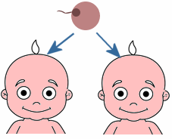
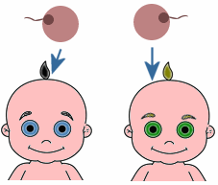
The genetic basis of behaviour
Label the diagrams to show MZ and DZ twins and then define these.
Feature | Interpretation
MZ concordance is significantly higher than DZ concordance
MZ concordance is the same or similar to DZ concordance
MZ concordance is 100%
MZ concordance is significantly less than 100%
Complete the table about concordance using the terms below:
The disorder has an environmental component
The disorder has a genetic component
The disorder is environmentally caused
The disorder is genetically caused

Slide 16
In a study of depression, a researcher investigated the genetic basis of behaviour. One way to do this is to compare the concordance rates for identical twins (monozygotic) who have exactly the same genes with non-identical (dizygotic) twins who share about 50% of the same genes. Both kinds of twins grew up in similar environments. Concordance rates express the likelihood that a trait present in one twin is also found in the other twin.
The following mean concordance rates found by the researcher were:
Monozygotic (MZ) twins – 49%
Dizygotic (DZ) twins – 17%
Ordinary siblings – 9%
Is this a lab, field, natural or quasi experiment? Justify your answer. (2 marks)
What type of experimental design has been used? Explain your answer. (2 marks)
Identify the IV and DV within this experiment. (2 marks)
Explain what the findings tell us about the genetic basis of depression. Refer to all three findings in your answer. (3 marks)

Slide 17
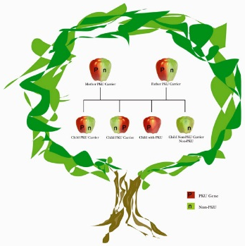
Genotype and phenotype
Genotype is…
Phenotype is…

Slide 18
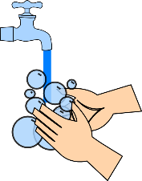
Evolution
What are the adaptive advantages of the following?
Memory
Evolution is…
Attachment (Bowlby’s theory)
Natural selection is…
Mental disorder e.g. OCD having a genetic basis

Slide 19
Name the types of neuron below and describe their functions
Dendrites
Synapse
Relay neuron/interneuron
Axon terminal
Axon
Nucleus
Nodes of Ranvier
Sensory neuron
Schwann cells
Cell body
Add the following labels to the diagram:
Colour:
The cell body – red
Dendrites - pink
The nucleus – orange
Myelin sheath – yellow
Nodes of Ranvier – green
Schwann cells – blue
Axon terminal - purple
Synapse
Dendrites
Motor neuron
Nucleus
Nodes of Ranvier
Schwann cells
Axon terminal
Axon
Cell body

Slide 20
Neuron structure quiz
Dendrites
Pre-synaptic terminal
Synapse
Myelin
Answer the clues below and then label these features on the diagram of the neuron
Soma
Schwann cells
Axon
Nucleus
Nodes of Ranvier
Part of the neuron that releases neurotransmitters into the synaptic cleft
Fatty material that insulates the neuron enabling faster transmission
Takes information away from the cell body
Pre-synaptic terminal
Myelin
Axon
The segments in the myelin sheath
The part of the neuron that contains the nucleus
Takes information to the cell body
Nodes of Ranvier
Soma (cell body)
Dendrites
The organelle in the neuron that contains genetic material
Produce myelin
The gap separating two neurons
Nucleus
Schwann cells
Synapse

Slide 21
Neurons and synaptic transmission
G
Action potential (post-synaptic neuron)
Action potential (pre-synaptic neuron)
Calcium channels
Cell body
Dendrites
Myelin sheath
Neurotransmitter
Nodes of Ranvier
Nucleus
Post-synaptic neuron
Pre-synaptic neuron
Receptor
Synapse
Synaptic terminal
Synaptic vesicles
A
C
O
B
K
M
C
O
N
A
M
L
D
J
K
L
E
J
N
H
B
F
I
I
F
H
D
G
E

Slide 22
Synaptic transmission
This triggers the nerve-ending of the pre-synaptic neuron to release chemical messengers called neurotransmitters.
1
An electrical impulse travels along the axon of the transmitting neuron.
2
3
These chemicals diffuse across the synapse (the gap) and bind with receptor molecules on the membrane of the next neuron.
4
The receptor molecules on the second neuron bind only to the specific chemicals released from the first neuron. This stimulates the second neuron to transmit the electrical impulse.
5
Reuptake: the neurotransmitter is reabsorbed in the vesicles of the pre-synaptic neuron after it has performed its function of transmitting a neural impulse.
This triggers the nerve-ending of the pre-synaptic neuron to release chemical messengers called neurotransmitters.
The receptor molecules on the second neuron bind only to the specific chemicals released from the first neuron. This stimulates the second neuron to transmit the electrical impulse.
Reuptake: the neurotransmitter is reabsorbed in the vesicles of the pre-synaptic neuron after it has performed its function of transmitting a neural impulse.
An electrical impulse travels along the axon of the transmitting neuron.
These chemicals diffuse across the synapse (the gap) and bind with receptor molecules on the membrane of the next neuron.

Slide 23
Synaptic transmission missing blanks
Neurons communicate with each other within groups known as neural networks. Each neuron is separated from the next by a tiny gap called the synapse. Signals within neurons are transmitted electronically (the positive charge inside the neuron is called the action potential) however, signals between the neurons are transmitted chemically across the synapse.
When the electrical impulse reaches the end of the neuron (the presynaptic terminal), it triggers the release of neurotransmitter e.g. acetylcholine from tiny sacs called synaptic vesicles. Neurotransmitters are chemicals that diffuse across the synapse to the next neuron in the chain (the post-synaptic neuron).
Once the neurotransmitter crosses the gap, it is taken up by the post-synaptic receptor site – in other words, the dendrites of the next neuron. Here, the chemical message is converted back into an electrical impulse and the process of transmission begins again in this other neuron with an action potential being fired. This whole process is known as synaptic transmission.
Several dozen types of neurotransmitter have been identified in the brain (as well as the spinal cord and some glands). Each neurotransmitter has its own specific molecular structure that fits perfectly into a postsynaptic receptor site (similar to a lock and key). Neurotransmitters also have specialist functions. For instance, acetylcholine (ACh) is found at each point where a motor neuron meets a muscle and upon its release, it will cause muscles to contract.
Neurotransmitters have either an excitatory or inhibitory effect upon a neighbouring neuron. For instance, the neurotransmitter serotonin causes inhibition in the receiving neuron, resulting in the neuron becoming more negatively charged and less likely to fire. In contrast, adrenaline (an element of the stress response which is both a hormone and a neurotransmitter) causes excitation of the post-synaptic neuron by increasing its positive charge and making it more likely to fire.
ACETYLCHOLINE
ACTION POTENTIAL
ADRENALINE
BRAIN
CHEMICALLY
CHEMICALS
CONTRACT
DENDRITES
ELECTRONICALLY
EXCITATORY
INHIBITORY
MOLECULAR
MUSCLE
NEGATIVELY
NEURAL NETWORKS
NEUROTRANSMITTER
POSITIVE
POST-SYNAPTIC NEURON
PRESYNAPTIC TERMINAL
RECEPTOR SITE
SEROTONIN
SYNAPSE
SYNAPTIC TRANSMISSION
SYNAPTIC VESICLES
TRANSMISSION

Slide 24
Fight or flight
Clare was telling her friend Rachel the following story:
“I was walking home by myself in the dark. Suddenly, I heard a shuffling noise behind me. I realised it was coming closer. I saw a bus at the bus stop and decided to run. I could hear the footsteps getting closer. I don’t think I ever moved so quickly. I leapt on the bus shaking and sweating with my heart beating so fast. I turned to see an empty street as the bus pulled away. Had I imagined it?”
Outline the role of the CNS and ANS in behaviour referring to Clare’s experience in your answer.
Place numbers in the circles to show the correct sequence of events
6
This generates the fight or flight response
2
The pituitary gland releases ACTH
4
The adrenal glands release adrenaline into the bloodstream
1
The ANS changes from its normal resting state (parasympathetic nervous system) to the physiologically aroused sympathetic state
7
The threat passes and the parasympathetic nervous system returns the body to its resting state.
3
ACTH has an effect on the adrenal gland
5
Adrenaline causes physiological changes

Slide 25
The endocrine system
Label the parts of the endocrine system
Gland | Hormone | Target organ | Function
Adrenal | Adrenaline | Vital organs e.g. liver and heart | Prepares the body for action – flight or flight
Pituitary | ADH | Kidney | Controls blood water level by triggering uptake of water in kidneys.
Ovaries | Oestrogen | ovaries, uterus, pituitary gland | Controls puberty and the menstrual cycle in females; stimulates production of LH and suppresses the production of FSH in the pituitary gland.
Pancreas | Insulin | Liver | Controls blood sugar levels.

Slide 26
Multi-choice quiz
Which division of the nervous system is divided into sympathetic and parasympathetic branches?
Which describes the somatic nervous system?
The master endocrine gland is the…
Which is NOT an action of the parasympathetic branch of the ANS?
A The Central nervous system
B The peripheral nervous system
C The somatic nervous system
D The autonomic nervous system
A maintains homeostasis by regulating body temperature, heartbeat etc.
B Made up of the brain and spinal cord
C Controls muscle movement
D Passes messages to and from the brain and connects nerves to the PNS
A Adrenal gland
B Pituitary gland
C Thyroid gland
D Hypothalamus
A Inhibits digestion
B Contracts pupils
C Stimulates saliva production
D Decreases heart rate
Which of the following carries messages from the PNS to the CNS?
Which is NOT part of the basic structure of a neuron?
Which of the following does NOT occur during synaptic transmission?
The following describes what process?
“when a neuron is activated by a stimulus, the inside of the cell becomes positively charged for a split second. This creates an electrical impulse that travels down the axon towards the end of the neuron”
A Sensory neuron
B Motor neuron
C Relay neuron
D Synaptic neuron
A Cell body
B Axon
C Effector
D Dendrite
A The neuron is in a resting state
B An electrical impulse triggers the release of neurotransmitter
C Neurotransmitter diffuses across the synaptic gap
D The chemical message is converted back into an electrical impulse
A Synaptic transmission
B Inhibitory response
C Pre-synaptic terminal
D Action potential

Slide 27
The genetic basis of behaviour
Label the diagrams to show MZ and DZ twins and then define these.
Feature | Interpretation
MZ concordance is significantly higher than DZ concordance | The disorder has a genetic component
MZ concordance is the same or similar to DZ concordance | The disorder is environmentally caused
MZ concordance is 100% | The disorder is genetically caused
MZ concordance is significantly less than 100% | The disorder has an environmental component
MONZYGOTIC
Complete the table about concordance using the terms below:
The disorder has an environmental component
The disorder has a genetic component
The disorder is environmentally caused
The disorder is genetically caused
DIZYGOTIC

