Slide 1
Chemistry
Melting & boiling points - R

Slide 2
Lesson objectives
Identify the state of a substance from its melting & boiling point

Slide 3
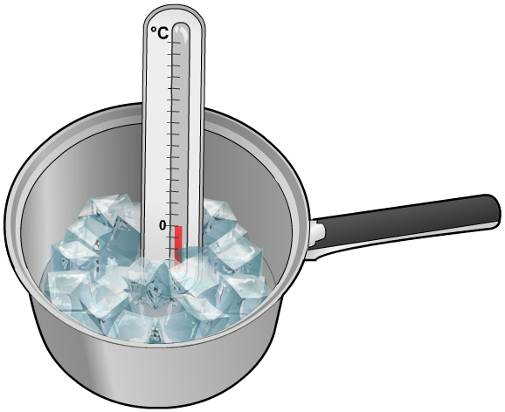
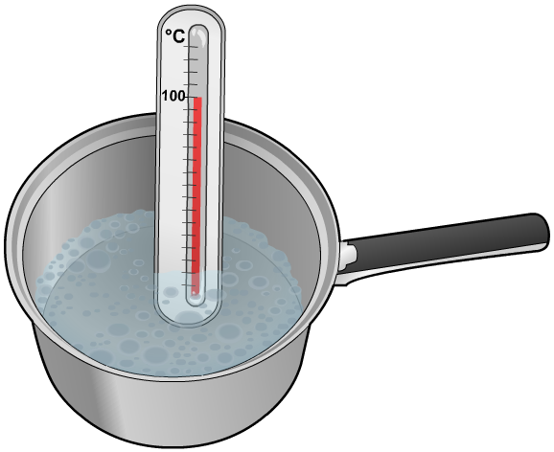
Melting point and boiling point
The temperature at which a substance changes from a solid to a liquid is called its melting point (or freezing point).
What is the melting point of pure water?
The temperature at which a substance changes from a liquid to a gas is called its boiling point.
What is the boiling point of pure water?
What state is water at 25 °C, 300 °C and 100 °C?
Notes:
Solids, Liquids and Gases Worksheet 1 accompanies this slide.

Slide 4
Heating curve
energy is being used to push the particles further apart
Temp/^{O}C
150
100
50
0
-50
gas
boiling
point
energy is being used to break particles apart
liquid
melting
point
Time/s
solid

Slide 5
Temperature scales

Slide 6
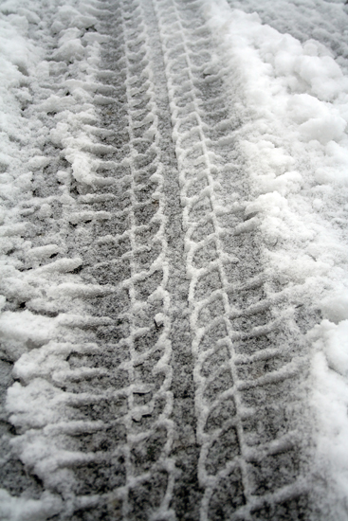
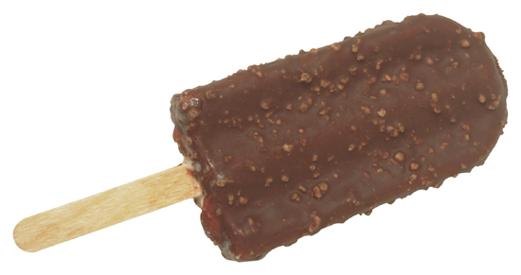
Reducing the freezing point of water
Salt reduces the freezing point of water. This means that the temperature has to be much colder than 0 °C for it to freeze.
Can you explain why people put salt on roads and paths during icy weather?
In what other situations would it be useful to reduce the freezing point of water? How about in making ice-cream?
Notes:
Photo credit (left and right): © 2008 Jupiterimages Corporation

Slide 7
Melting & boiling points
Boiling point 100ºC
Room temperature 25ºC
LIQUID
Melting point 0ºC

