Slide 1
Chemistry
Classifying materials - R

Slide 2
Lesson objectives
To be group materials as solid, liquid or gas
List the properties of each group

Slide 3
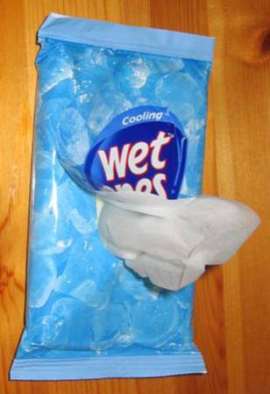
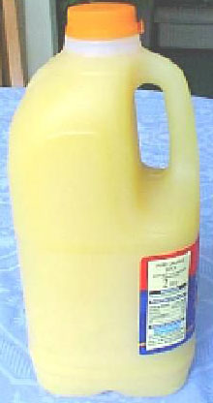
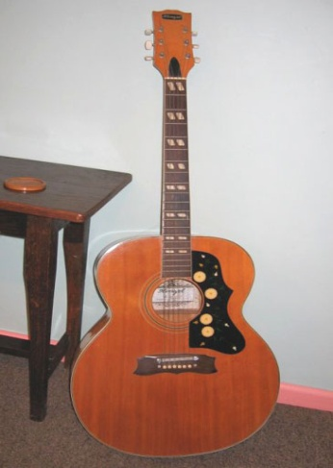
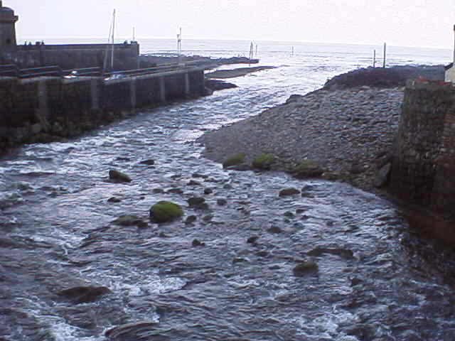
Three states of matter
At room temperature most substances exist in one of three physical states.
solid
liquid
gas

Slide 4
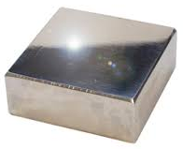
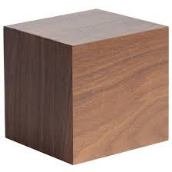
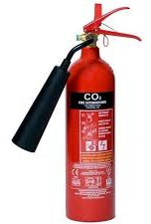
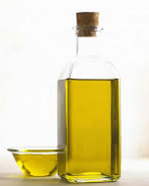
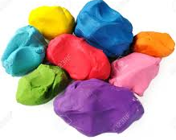
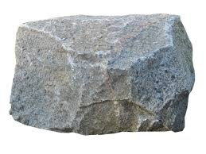
Task: Three states of matter - materials
S
S
L
wood
metal
water
G
L
milk
G
oxygen
L
carbon dioxide
G
oil
S
S
nitrogen
plasticine
rock

Slide 5
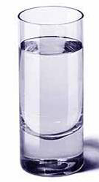
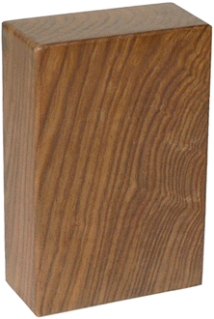
How did you group them?
air
properties

Slide 6
Properties of materials
Properties describe how a material behaves and helps us to classify (group) them as solids, liquids or gases.
Shape
Volume
Fluidity
Compressibility
Density
Diffusion
Pressure
can it change
the space taken up
can it flow
can it be squashed
how heavy for the volume
can it spread out
can it create pressure

Slide 7
Investigating properties of materials
Observation | Solid | Liquid | Gas
Shape
Fluidity
Compressibility
Volume
Density
fixed
not fixed
not fixed
can’t flow
can flow
can flow
can’t be squashed
can’t be squashed
can be squashed
fixed
fixed
not fixed
high
high
low

