Slide 1
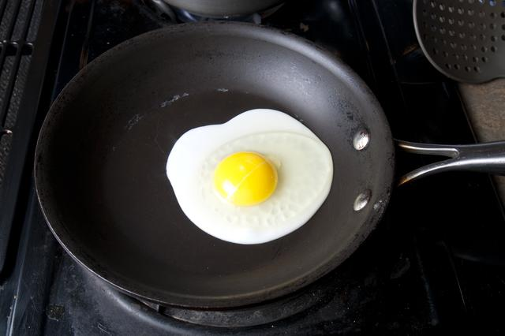
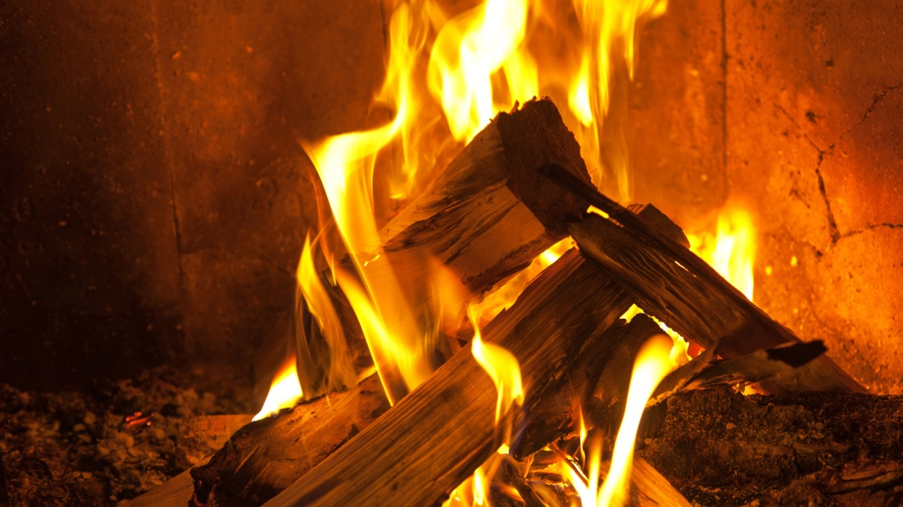
Chemical Reactions
Review

Slide 2
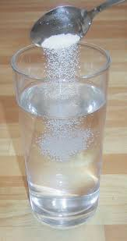
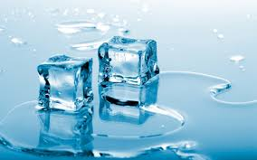
Physical Changes
In a physical change, no new substance is made.
You can get back what you started with, it is reversible
A physical change is a temporary change.
Eg. melting, dissolving

Slide 3
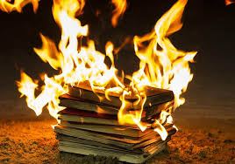
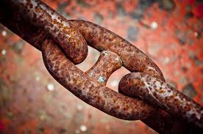
Chemical changes
A chemical change, a new substance has been made,
You cannot get back what you started with; it is irreversible
Chemical changes are permanent
Eg. Rusting, burning
Chemical changes are represented with word equations
Reactants Products
Chemicals you start with and react together
Chemicals you make at the end of the reaction

Slide 4
Chemical changes
If there is a chemical reaction you might see:
Smoke
Bubbles
Colour change
Temperature change
Chemicals appearing/disappearing
Smells

Slide 5
Testing Gases
Gas | Test
Oxygen
Hydrogen
Carbon dioxide
Relights a glowing spill
Pops with a lit spill
Turns limewater cloudy

Slide 6
Acid and Metal Word Equations
When metals react with acids, they always make a salt and hydrogen gas
The test for hydrogen gas is that it pops with a lit splint
The name of the salt that is made will depend on the type of acid and the name of the metal that reacts.
acid + metal metal salt + hydrogen
Pops with a lit splint

Slide 7
Naming Salts
The salt has a first name and a surname
The first name comes from the metal
The surname comes from the acid
metal + hydrochloric acid metal chloride + hydrogen
metal + sulphuric acid metal sulphate + hydrogen
metal + nitric acid metal nitrate + hydrogen

Slide 8
Combustion & Thermal Decomposition
Combustion is the scientific word for burning it is the reaction where a substance burns with the oxygen in the air.
Thermal decomposition is the breakdown of a substance using heat.
Thermal = heat
Decomposition = to break down
Eg. Metal carbonates break down to make a metal oxide and carbon dioxide gas.
Eg. Calcium carbonate:
Heat
Calcium carbonate
Calcium oxide + Carbon dioxide
Heat
CaCO₃
CaO + CO₂
Turns limewater cloudy
Notes:
going to figure our thermal decomposition.

Slide 9
Burning
The fire triangle
fuel
heat
oxygen

Slide 10
Burning Fuels
A good fuel will:
burn for a long time
light easily
burn cleanly
give out a lot of heat
When a substance burns in air, it joins with oxygen to form an oxide.
eg. When magnesium burns in oxygen in the air, it forms magnesium oxide.
magnesium + oxygen magnesium oxide.

Slide 11
Rusting
Iron is the only metal that rusts.
Most metals react with oxygen in the air to form metal oxides. This is called corrosion.
When iron reacts with oxygen it forms a red oxide called rust.
Adding salt, water or acid can make the rust form quicker.
Millions of pounds are spent every year to try to prevent rusting.

Slide 12
Rust Prevention
There are many ways to try to stop rusting:
Painting:
This stops the oxygen making contact with the iron so stops rusting.
Adding oil or grease:
This forms a barrier so the oxygen cannot react with the iron.
Galvanising:
The iron is coated with a more reactive metal so that metal reacts with the oxygen first.

