Slide 1
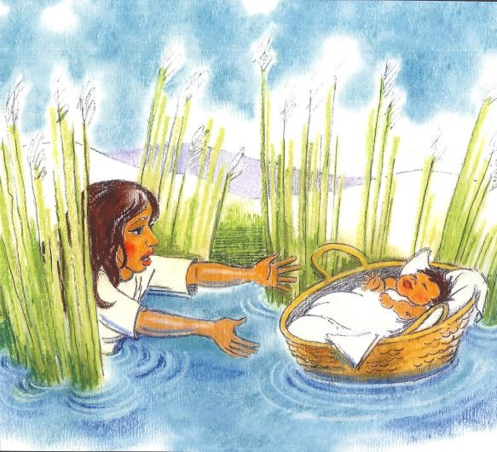
Do you know what’s going on in this picture?

Slide 2
Today’s Title: Passover Learning Outcomes
DESCRIBE the story of Moses, the Passover and the Exodus
EXPLAIN how Jews celebrate Passover/Pesach
ASSESS whether the story of Passover shows a loving God

Slide 3
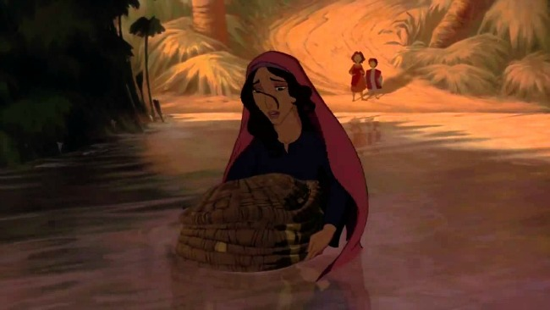
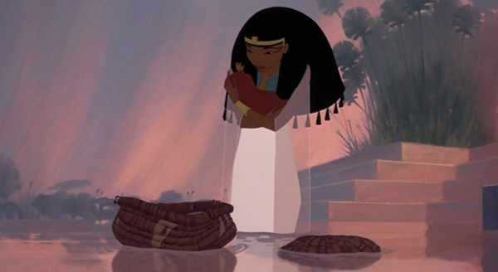
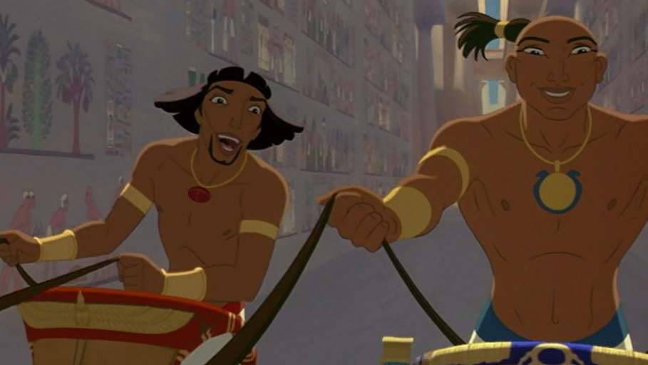
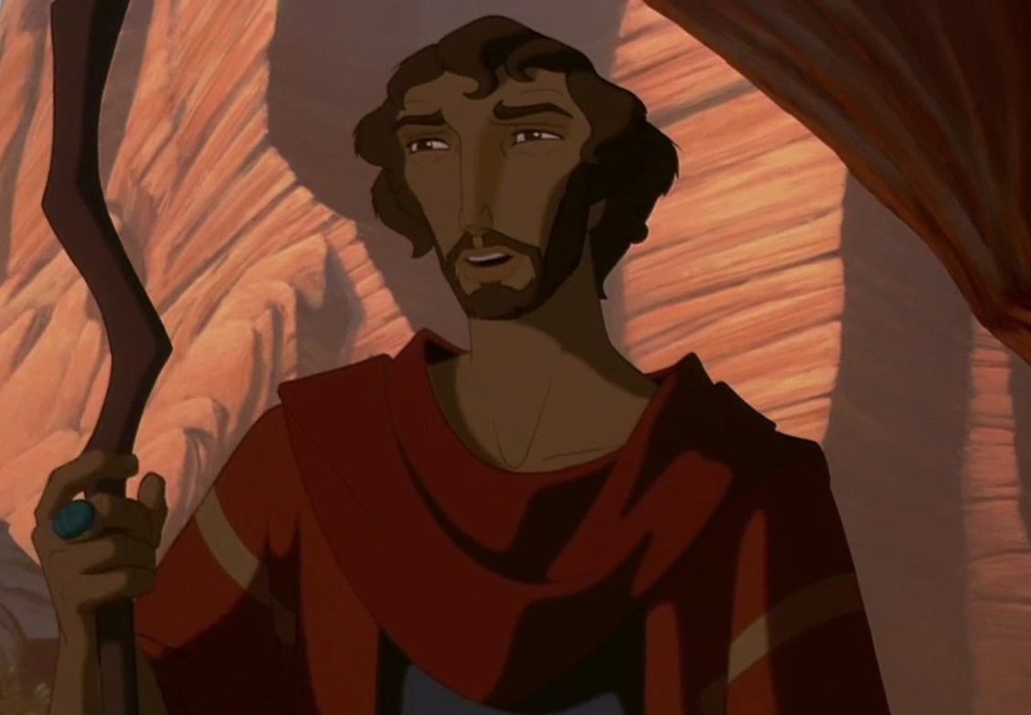
1
2
3
4
DESCRIBE the story of Moses, the Passover and the Exodus
Notes:
Either ask students to explain what is happening in these pictures or simply explain to set up the video. 1 = The Pharoah is killing Jewish children so Moses’ mother put him in a basket and sent him down the river. 2 = Pharoah’s wife finds Moses and raises him as his own. 3 = Moses and his ‘brother’ Rameses are the Princes of Egypt and Rameses becomes Pharoah. 4 = Moses learns he is a Jew. The video picks up the story from there.

Slide 4
As you watch the rest of the story, you need to storyboard what happens.
DESCRIBE the story of Moses, the Passover and the Exodus
Notes:
Click on Prince of Egypt poster to open the video file, and on the play button to play the video in the powerpoint.

Slide 5
Was God wrong to kill the Egyptian children?
Yes
No

Slide 6
How do Jews celebrate Passover?
Jews celebrate Passover to remember the time the Angel of Death passed over the houses of the Jews and helped them to become free from slavery.

Slide 7
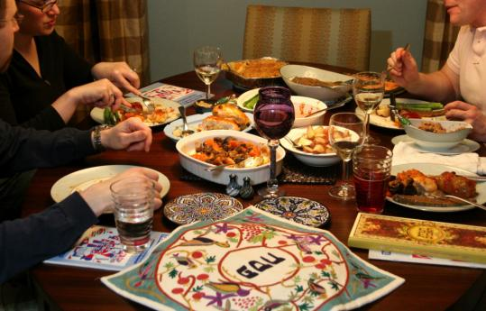
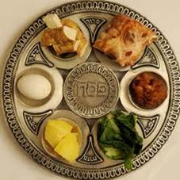
Can you match up the parts of the Seder meal with what they represent?
Represents the tears of the Israelite slaves in Egypt
Represents a fresh start after Egypt.
Represents the mortar used by the slaves to make bricks in Egypt
Represents the Lamb sacrificed for the blood to put on the doors
Represents the speed with which they had to leave Egypt.
Represents the bitter times of slavery in Egypt.
Represents a new life after Egypt.

Slide 8
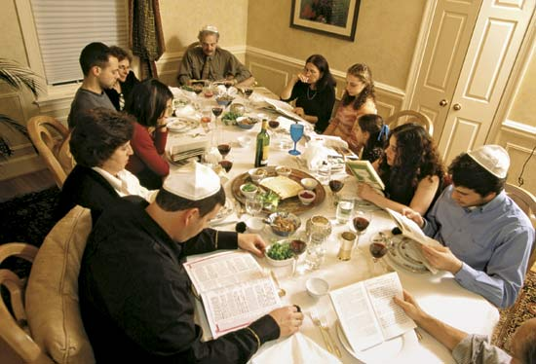
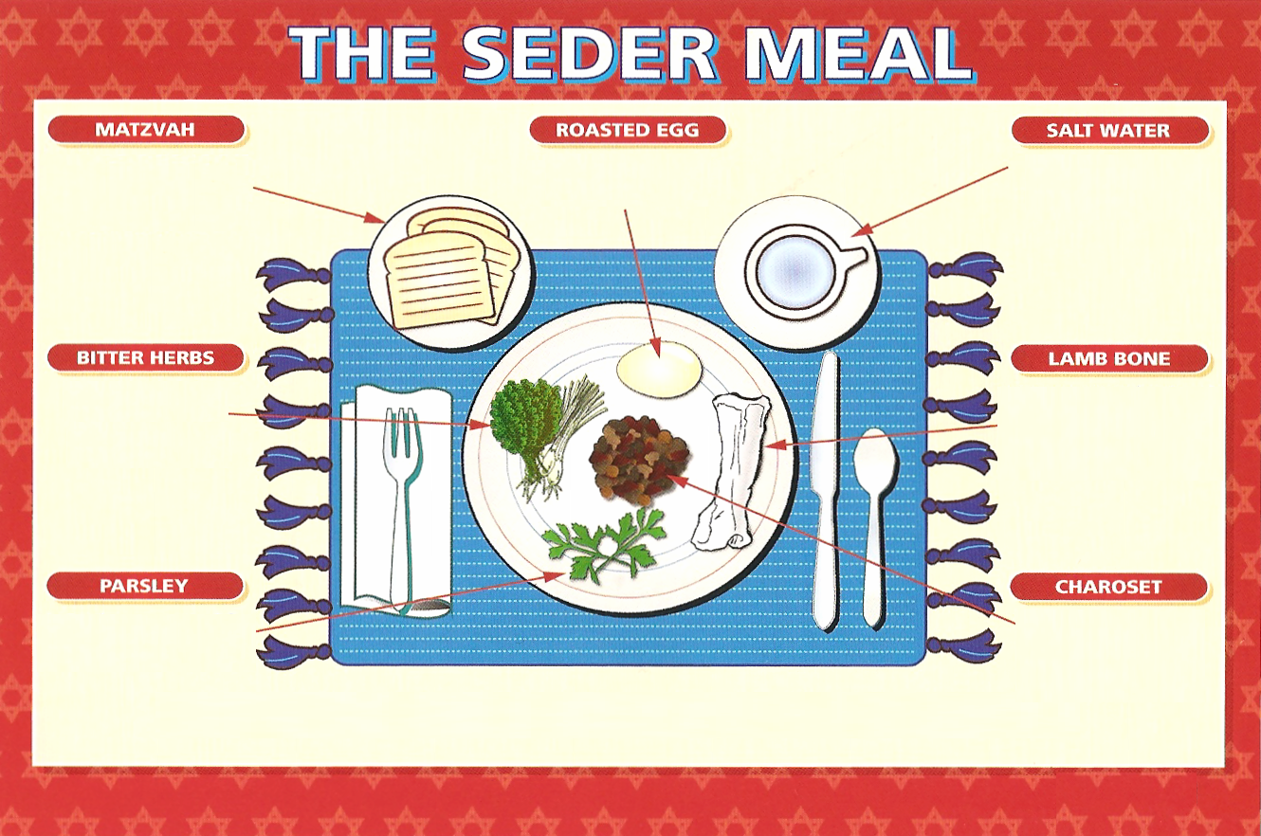
The Seder Meal reminds Jews of how they were set free from Egypt long ago
Notes:
Sitting round a table sharing food from the meal

Slide 9
Represents the speed with which they had to leave Egypt
Represents a new life after Egypt
Represents the tears of the Israelite slaves in Egypt
Represents the bitter times of slavery
Represents the Lamb sacrificed for the blood to put on the doors
Represents a fresh start after Egypt
Represents the mortar used by the slaves to make bricks in Egypt
The Seder Meal reminds Jews of how they were set free from Egypt long ago
Notes:
Sitting round a table sharing food from the meal

Slide 10
… because ….
The Passover story shows that God is …
ASSESS what the story of Passover shows about God

