Slide 1
Revision 5th May

Slide 2
10 mark with item timed
Hannah – Marxism and crime
Taliya and Sophie – gender and ed
10 marks = 15 minutes (18.75 with extra time)

Slide 3
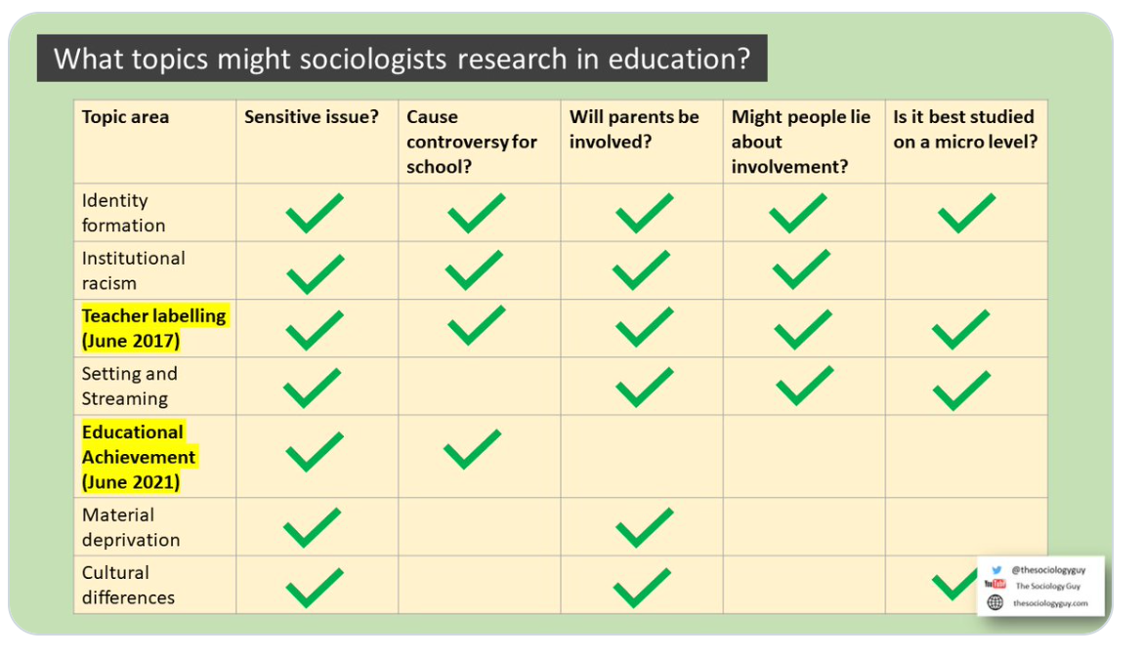

Slide 4
Brain storm
What do we need to think about with
Pupils
Teachers
Parents

Slide 8
Marking of sample answer

Slide 9
Methods and method in context

Slide 10
Focus today on methods in context questions.
Themes | Methods | Study
Pupils Teachers Schools Parents Classrooms | Documents Official Stats Questionnaires Interviews Experiments Observations | Permanent exclusion Truancy Subcultures Achievement Parental involvement Gender Identity Class, Ethnicity and Language Labelling Teacher Expectations Classroom Interactions

Slide 11
Improving answers with examples
Spend some time putting together examples of studies from everything we have done for the methods areas. Start by brainstorming what examples you can remember for
Qualitative
Quantitative
Questionnaires
Experiments (and sampling)
Interviews
Statistics
Experiments
Observation
Documents.

Slide 12
Questionnaires
Chubb and Moe base their arguments on a comparison of the achievements of 60,000 pupils from low income families in 1,015 state and private high schools, together with the findings of a parental survey and case studies of ‘failing’ schools apparently being turned around. Their evidence shows that pupils from low income families consistently do about 5% better in private schools.
Method Link: Using Surveys
Based on these findings carried out a survey of parental attitude to schooling. Surveys involve asking people a fixed set of questions either: through interviews or written questionnaires. This is a very quick way of collecting data from a large sample of people. Chubb and Moe chose this method so as to make generalisations about parental views on the way schools should run and how much choice parents should get.

Slide 13
Interviews -
Becker Interviewed 60 high school teachers in Chicago, asking them what their ideal pupil would be.
Lacey In the study, the school was viewed as a social system which was nevertheless embedded in a wider society. In the case study, Lacey lays bare the social mechanisms (differentiation and polarisation) within the school in an attempt to explain the disappointing performance of working-class boys in grammar schools.
Data collection:
observed teachers giving lessons (at least one by every member of staff) to gain a clearer picture of what was happening in the school
spent twelve weeks sessions per week teaching and twelve observing teachers at work which continued over eighteen months
engaged staff and pupils in informal conversations
during the first term, Lacey sent out two questionnaires to 1st years (Year 7) and 5th years (Year 11) after their exams asking details about values, career aspirations, family background and peer group affiliation
material from school records and the local education offices were also used.
Paul Willis used a wide range of research methods - including observations and interviews - to really try and see education from the children's point of view. As a Marxist, he was interested in conflict in education and why working-class children went on to do working-class jobs. But he reached quite different conclusions from Bowles & Gintis.
Gewitz et al 3 main types of parents Privileged-skilled workers
Disconnected-local choosers
Semi-skilled choosers

Slide 14
Examples from crime and deviance?

Slide 15
Observations
Ball – beachside comprehensive
Keddie - Although cultural deprivation theorists have provided some evidence for the effects one educational achievement there are still some criticisms of this approach. Keddie describes cultural deprivation as a myth and a victim blaming explanation. She argues working class families are different not deprived and fail because of biases in education system which put working class families at a disadvantage.

Slide 16
Statistics
Durkheim
Gilborn and Youdell believed that teachers were not intentionally racist, in fact most of them were committed to equality of opportunity.
However, they also found that teachers tended to have lower expectations of black students compared to white students, which resulted in them being put in the lower sets, and written off as having no hope of ever achieving five good GCSE grades.
In Clough School for example, 29% of white students but 38% of black students where written off into the lower sets.

Slide 17
Experiments?
Rosenthal’s and Jacobson’s IQ test
Hawthorne?
The Rosenhan experiment or Thud experiment was an experiment conducted to determine the validity of psychiatric diagnosis. The participants feigned hallucinations to enter psychiatric hospitals but acted normally afterwards. They were diagnosed with psychiatric disorders and were given antipsychotic medication
The Milgram experiment(s) on obedience to authority figures was a series of social psychology experiments conducted by Yale University psychologist Stanley Milgram. ... Participants were led to believe that they were assisting an unrelated experiment, in which they had to administer electric shocks to a "learner"

Slide 18
Strengths and weaknesses of each?
Qualitative
Quantitative
Questionnaires
Experiments (and sampling)
Interviews
Statistics
Experiments
Observation
Documents.

Slide 19
10 mark questions
Outline and explain
Outline and explain two problems of using primary qualitative methods in sociological research
Outline and explain
Outline and explain two disadvantages of using personal documents in sociological research.
Outline and explain
Outline and explain two practical disadvantages of using documents in sociological research.
Outline and explain
Outline and explain two problems of using the functionalist perspective to study today’s society.

Slide 20
Outline and explain two reasons why Positivists generally prefer to use quantitative methods (10)
The theory and methods 10 mark question appears as a special treat at the end of paper 1 (Education, Methods in Context and Theory and Methods), you’ll also get a big 30 mark essay question at the end of paper 3 (Crime and Deviance with Theory and Methods) too, but more about the 30 markers in other blog post.
For 10 mark questions it’s good practice to select two very different reasons, which are as far apart from each other as possible. In this question, it’s also good practice to contrast Positivism to Interpretivism (to get analysis marks) and to use as many theory and methods concepts and examples as possible.
The first reason is that Positivists are interested in looking at society as a whole, in order to find out the general laws which shape human action, and numerical data is really the only way we can easily study and compare large groups within society, or do cross national comparisons – qualitative data by contrast is too in-depth and too difficult to compare.
Numerical data allow us to make comparisons easily as once we have social data reduced down to numbers, it is easy to put into graphs and charts and to make comparisons and find correlations, enabling us to see how one thing affects another.
For example, Durkheim famously claimed that the higher the divorce rate, the higher the suicide rate, thus allowing him to theorise that lower levels of social integration lead to higher rates of suicide (because of increased anomie).
The second reason for preferring quantitative methods is that Positivists think it is important to remain detached from the research process, in order to remain objective, or value free.
Quantitative methods allow for a greater level of detachment as the researcher does not have to be directly involved with respondents, meaning that their own personal values are less likely to distort the research process, as might be the case with more qualitative research.
This should be especially true for official statistics, which merely need to be interpreted by researchers, but less true of structured questionnaires, which have to be written by researchers, and may suffer from the imposition problem.

Slide 21
Focus today on methods in context questions.
Themes | Methods | Study
Pupils Teachers Schools Parents Classrooms | Documents Official Stats Questionnaires Interviews Experiments Observations | Truancy Subcultures Achievement Parental involvement Gender Identity Class, Ethnicity and Language Labelling Teacher Expectations Classroom Interactions

Slide 22
Primary qualitative methods problems….
Consider key vocab
Examples!
Analysis – this means linking evidence to the question. Explaining these links and link to other areas. Link between your two points

Slide 23
Left and Right realism and crime
Card match and Kahoot

Slide 24
Be very clear about……
Causes / solutions / strengths and weaknesses

Slide 25
Marking of sample answer

