Slide 1
GCSE Computer Science (9-1)
Fundamentals of programming
Lesson 5: data structures

Slide 2
Lesson Objectives
Understand the concept of data structures
Use arrays in the design of solutions to simple problems
Use records in the design of solutions to simple problems

Slide 3
Look at the following code
Name1 ← “Adam”
Name2 ← “Bernice”
Name3 ← “Charlie”
Name4 ← “Dan”
Name5 ← “Eliana”
How robust/efficient do you think it is?

Slide 4
Data Structures in Programming
In Computing, at times we need to organise data, so that it is suitable for computer processing
We can organise data using variables
Recap: What is a variable?
A variable is a user-defined value that is stored in a memory address
Memory Addresses are physical addresses in memory

Slide 5
Variables
When we think of a variable, we often think of a box that stores an item
Now consider – what if we wanted to have multiple boxes in one area?

Slide 6
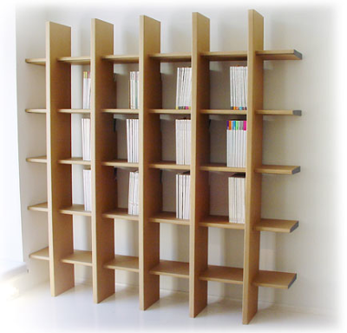
Data Structures
To store multiple boxes in one place, we would have them, perhaps, on a shelf
Arrays work in the same way
Arrays are data structures made up of a series of variables, of the same data type, grouped under one identifier
Elements are accessed using an index

Slide 7
Listing
Say we wanted to have a list of hardware items
This would be defined as
Arrays are defined using square brackets
Key Point: Computer counting and indexing starts from 0
Hardware ← [“Motherboard”, “CPU”, “Mouse”, “Keyboard”, “Monitor”]

Slide 8
Array Indexing
You need to know and remember that computers count from zero, and that array indexes go from that same value
The indexing works the same as memory addressing – a storage space within an identified location
What would happen if we declared the following statement?
Hardware ← [“Motherboard”, “CPU”, “Mouse”, “Keyboard”, “Monitor”]
Hardware[0] = “Motherboard
Hardware[1] = “CPU”
Hardware[2] ← “Printer”

Slide 9
Arrays are mutuable
The term mutuable is also known as “changeable”
We can change the index values of arrays through declaration and assignment
However – Arrays cannot be added to using declaration and assignment, they need to be appended or added to

Slide 10
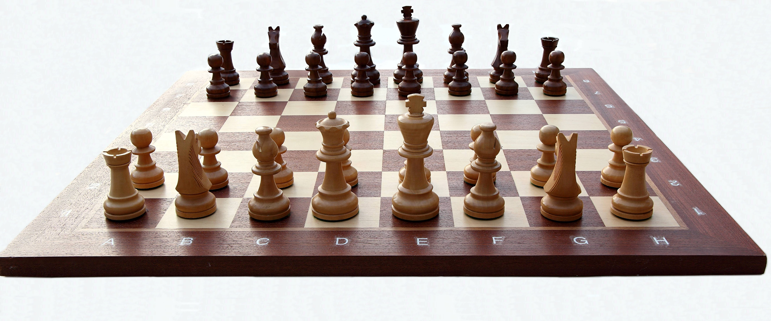
Consider
Is this an array? How can you tell?

Slide 11
Two-dimensional data structures
A chess board is a perfect example of a 2D array
Each row is numbered from 1-8
Each row has its own position – we could say that the index value could store a chess piece
Task 1: Write a program in a new MS Word document, firstly, to create an array that stores a student’s 5-period subject day on a Monday
Task 2: Now extend this program to use a 2-D array to create a weekly timetable. Set the value of Wednesday Period 3 to “Maths”

Slide 12
Let’s Chat Programming…
Over the past few lessons, you have been learning (or perhaps, recapping) programming techniques, constructs and concepts
You will need to know these for your Non Exam Assessment
Homework: You have a week today to write all algorithms and pseudocode examples from any worksheets/examples in the programming language of your choice

